Slide 1


Emotional Based School Avoidance
Attendance & Punctuality
Information for Families

Slide 2
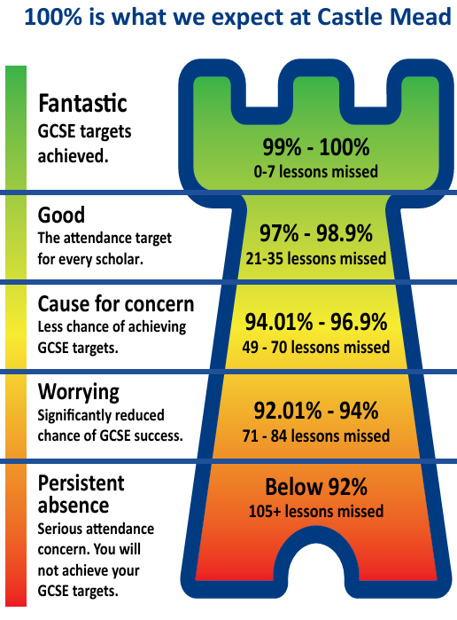
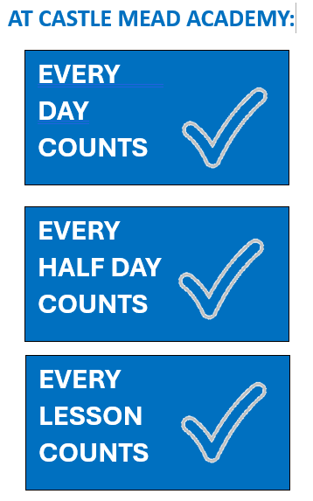
It is essential that your child attends school as regularly as possible. There is a great deal of research showing that attendance has a huge impact on how well children do in school. Any absence affects the pattern of a child’s education, and regular absence seriously affects their progress.
Scholars who have time off school often find it difficult to catch up on work they have missed. In addition, post-16 providers and employers always ask us about a scholars’s attendance and punctuality.
We want every scholars to be happy and to enjoy school, feeling safe, secure and cared for.
We work in partnership with families, scholars and the wider community in order to make this vision a reality. Everything, however, depends on attendance - being in school and in lessons, taking part in learning, getting actively involved.
We expect all of our Castle Mead Academy scholars to be in school every day unless the reason for absence is unavoidable.
Every Day Counts

Slide 3
The minimum expected level of attendance for every scholar at Castle Mead Academy is 97%. This is equivalent to no more than four days’ absence each school year.
We will keep all families up to date with their child’s attendance regularly throughout the year, and we get in touch as soon as attendance becomes a cause for concern.
We show how attendance compares with government expectations. The government considers attendance below 95% to be unsatisfactory. Our minimum target is higher because we know just how important attendance is to progress and achieve.
You can easily monitor your child’s attendance via MCAS. Please contact us if you need help logging in.
Your Child’s Attendance
Our minimum attendance target is 97% and we want every scholar to aim for 100%.
ATTENDANCE
THE STAGES
STAGE 1
STAGE 2
STAGE 3
We will text, telephone or visit your home on the first day of absence if we have not heard from you.
If your child’s absences are increasing and we are not aware of a good reason for this, we will invite you into school to meet with your child’s Year Team and/or a school attendance officer. Support will be provided and monitored to work together.
If absence persists after all support provided, we may make a referral to the local authority.
If all other ways of trying to improve attendance have failed and unauthorised absence persists, the Local Authority may then proceed with the new fixed penalty notices. Please ensure you read the new guidance provided.

Slide 4
We will do our very best to support you in ensuring that your child attends school regularly. It is important that we work together. We will keep you informed of initiatives that focus on improving attendance. As a family, there are also things that you can do to help get your child into the habit of attending school regularly and on time.
Supporting Your Child
WAYS YOU CAN SUPPORT YOUR CHILD
1
Talk to your child about the importance of attending the academy.
Explain the impact that absences has on future life chances but also focus on the things that they enjoy about school
2
Make morning routines consistent and calm.
Try to keep to getting up at the same time every day, eating breakfast at the same time, leaving the house etc
3
Be consistent in your approach.
Make sure that you discuss with your child that going to school every day isn’t an option but a rule and that they understand this
4
Offer Reassurance.
Make sure your child knows that if they have any worries, they will have an adult to discuss these at the academy. We will always try to help and work with families
5
Ensure your child has a good night’s sleep every night.
Make the bedroom a quiet place for sleep rather than a place for watching devices/TV or game playing. Also, limit access to your child’s phone/devices at night so they rest and get enough sleep ready to learn and participate
6
Prepare everything the night before school.
Help your child get their equipment and getting their uniform and PE kit ready for the next day ahead
GOOD ATTENDANCE MEANS…
…a better chance of being successful in future life
…stronger friendships. Being in school regularly makes it easier to make and keep friends
…not missing out on lessons and other school activities / enrichment opportunities
…learning how to maintain good habits and not starting bad behaviour patterns ready for the future

Slide 5
Poor punctuality is not acceptable.
When a scholar arrives late to school, they fall behind with their work as well as missing important information and news for the day. Late-arriving scholars also disrupt lessons for others.
If your child arrives after Inspire time (registration time), they must sign in at reception. They will be marked as late on the register and receive behaviour points.
Safeguarding your child is important to us. If your child is late, you will receive a telephone call and/or message from one of our attendance team or Pastoral team (Heads of Year) each day to make you aware and offer support.
Punctuality
START OF THE
ACADEMY DAY
At Castle Mead Academy we expect all students to on site by 8:25am. Our Tutor Time begins at 8:30am.
Scholars line up in their year groups on the MUGA to be met by their Inspire tutors who then take them to their Tutor Time.
This ensures a calm and purposeful start to the school day.
If you are having any problems getting your child to attend school on time, please contact us and we will be happy to support you to resolve the problem.
If you are just 10 minutes late to school
every day, it means that you are missing
the equivalent of one lesson every week!
10
MINUTES
LATE
10
MINUTES
LATE
MORE ABOUT ATTENDANCE…
If you are having any issues getting your child to school on time, please phone us:
0116 214 3150
For more information about attendance please visit:
Castle Mead Academy Website

Slide 6
Attendance percentages can sometimes be a bit misleading. Let’s take 90% as an example. Getting a mark of 90% in an examination sounds really good. But in attendance terms 90% is not good. In fact, it is a cause for serious concern. The graphic below shows what 90% means in terms of lost learning time and the impact it can have on a child’s education.
Understanding Attendance Percentages
ATTENDANCE
WHAT 90% MEANS
What you miss each year
What you miss over five years
90%
Attendance
90
Days of lessons
100
Days of lessons
100+
Hours of learning
500+
Hours of learning
Year 7
Year 8
Year 9
Year 10
Year 11
Department for Education research
suggests that just 17 missed school
days a year equals a drop of a full
GCSE grade in every subject
17
DAYS OF
ABSENCE
17
DAYS OF
ABSENCE

Slide 7
The place for your child to be on a school day is at Castle Mead Academy.
If your child is not in school, you must have a valid reason. We ask that you contact us by phone, preferably before 8.00am, on each day of absence.
Your child is expected to attend school every day unless they are medically unfit or there is an urgent, unavoidable family reason why they are not able to attend.
Unavoidable Absence
INFORMATION WE WILL REQUIRE
Please ensure that you contact us by phone on each day of absence. We will require the following information:
Your child’s name and Year group
The reason for absence (each day)
A date you expect your child to be back in school
Please provide all medical evidence to show why your child is not attending school. This can be emailed or sent in with your child upon their return to school.
Contact us by phone:
0116 214 3150 on each day of absence
General enquiries or support: attendance@castle-tmet.uk
Attendance links to qualifications and future earnings. Below are the average weekly pay for full time employees by highest qualification
£788
Graduate
Level 4
£570
A-Levels
Level 3
£541
GCSE’s
Level 2
£408
No Qualifications (Minimum wage level)
4
4
4
4

Slide 8
Mr T Gardner
Assistant Principal Belonging
tgardner@castle-tmet.uk
Mrs B Rai
Attendance Manager
brai@castle-tmet.uk
Castle Mead Academy
Richard III Road
Leicester
LE3 5QT
0116 214 3150

