Slide 1


Do Now Task
Notes:
Tutors: Do not take questi

Slide 2
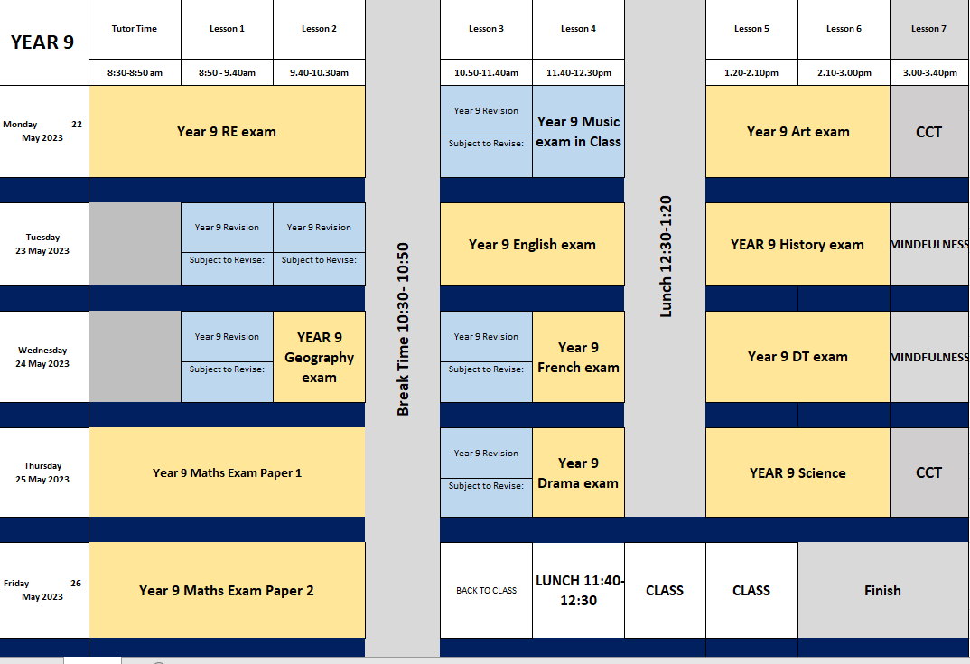
Summer End of Year Exam- Timetable
Add in which subjects you will revise for in your revision sessions.
Ensure you bring the correct revision materials with you.
You will also have your exam timetable printed which has your seat number on for each exam.
All of your exams are in the Sports Hall apart from your Music Exam. Just go to your usual Monday period 4 lesson for this.
Notes:
Tutors: Do not take questi

Slide 3
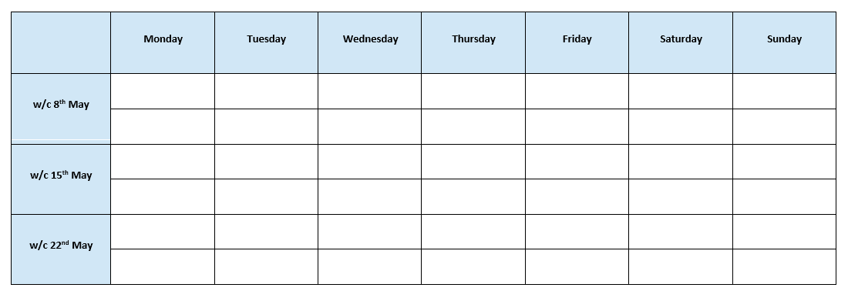
Revision Timetable
Add all of your subjects into the revision timetable below to support with your revision over the next few weeks.

Slide 4
Looking after yourself during Exam Week
End of year exams can be stressful, but don’t worry, it is normal to feel some nerves when you have exams approaching.
There are lots of different ways to prevent stress:
Exercise
Exercise reduces stress and produces endorphins (chemicals in your brain that make you feel good!).
Action: Go outside for a walk or do an indoor workout
2. Sleep
It is important that you get a good night sleep to help your brain to work!
Action: Get at least 8 hours of sleep a night.
3. Mindfulness
Sometimes we need a break from revising and doing some mindfulness activities can help declutter our brains.
Action: Complete some pages in your mindfulness booklets.
4. Talk to someone
If you feel too stressed, remember, you are not alone so talk to someone.
Action: Speak to your friends, families or member of staff if you are feeling really stressed.

Slide 5
How to Revise for English
Use the video to make notes on how best to revise for this subject.
1.
2.
3.

Slide 6
You will need to know:
The key conventions (what we can expect of) and structure of the Gothic
Definitions of subject terminology and examples from the texts that we have read (e.g foreshadowing, metaphor, rhetorical questions, symbol, motif, soliloquy, monologue, pathetic fallacy, verisimilitude, tone, declarative sentences, anecdote, anaphora, themes and setting)
The different forms of literature and their conventions (plays, poems, novels)
Key contextual details about the eras of the texts we’ve studied:
What they believed in the 19th (e.g. Dickens and Shelley)
What writers in the 21st century wrote about (e.g. Acevedo and Crossan)
Why writers were writing at each of these times
The conventions of different text types have studied (Letters, tragedies, comedies, novels, cautionary tales etc)
The key ideas, themes and messages of the texts we have studied
Key elements of rhetoric
The elements of grammar we have focused on in Language (including apostrophes, connectives, sentences that begin with a subordinate clause, the difference between compound and complex sentences)
You will need to know how to:
The stages of reading, annotating and analysing poetry (the three boxes at the bottom, what a good annotation looks like etc).
Write an analytical paragraph (how it is ordered; how you write a topic sentence)
Write a persuasive open letter.
Identify the parts of a metaphor and comment on the desired effect of that metaphor.
English

Slide 7
Revision List
You will need to bring your English books as well to revise.
Subject: English
Topic | ☺ | 😐 | ☹ | Revised?

Slide 8
How to Revise for Maths
Use the video to make notes on how best to revise for this subject.
1.
2.
3.

Slide 9
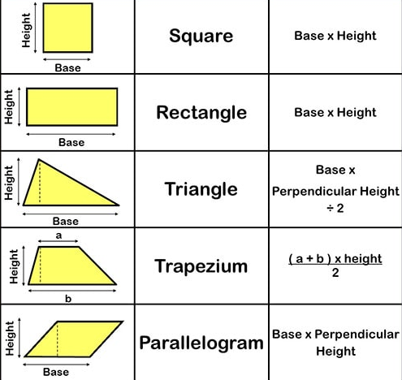
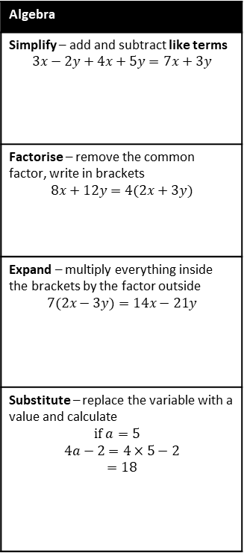
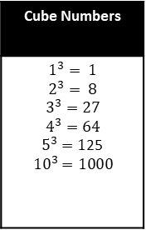
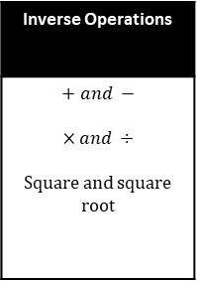
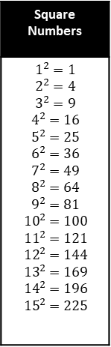
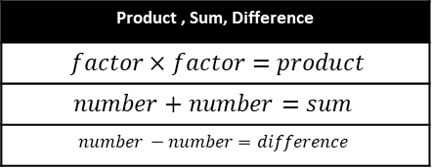
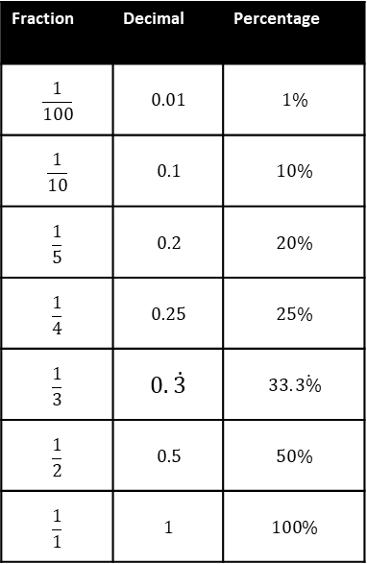

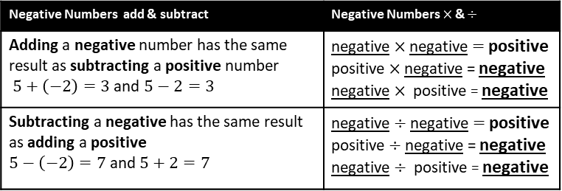
Castle Mead Mathematics – Facts to know
Square Numbers
$$1^{2}=1$$ $$2^{2}=4$$ $$3^{2}=9$$ $$4^{2}=16$$ $$5^{2}=25$$ $$6^{2}=36$$ $$7^{2}=49$$ $$8^{2}=64$$ $$9^{2}=81$$ $${10}^{2}=100$$ $${11}^{2}=121$$ $${12}^{2}=144$$ $${13}^{2}=169$$ $${14}^{2}=196$$ $${15}^{2}=225$$
Cube Numbers
$$1^{3}= 1$$ $$2^{3}= 8$$ $$3^{3}=27$$ $$4^{3}=64$$ $5^{3}=1$25 $${10}^{3}=1000$$
Inverse Operations
$$+ and −$$ $$×and ÷$$ Square and square root
Fraction | Decimal | Percentage
$$\frac{1}{100}$$ | $$0.01$$ | $$1\%$$
$$\frac{1}{10}$$ | $$0.1$$ | $$10\%$$
$$\frac{1}{5}$$ | $$0.2$$ | $$20\%$$
$$\frac{1}{4}$$ | $$0.25$$ | $$25\%$$
$$\frac{1}{3}$$ | $$0.\dot{3}$$ | $$33.\dot{3\%}$$
$$\frac{1}{2}$$ | $$0.5$$ | $$50\%$$
$$\frac{1}{1}$$ | $$1$$ | $$100\%$$
Prime Numbers (exactly two factors)
$2, 3, 5, 7, 11, 13, 17, 19, 23, 29, 31$…
Product , Sum, Difference
$factor×factor=product$
$$number+number=sum$$
$$number −number=difference$$
Algebra
Simplify – add and subtract like terms $$3x−2y+4x+5y=7x+3y$$
Factorise – remove the common factor, write in brackets $$8x+12y=4(2x+3y)$$
Expand – multiply everything inside the brackets by the factor outside $$7(2x−3y)=14x−21y$$
Substitute – replace the variable with a value and calculate $$if a=5$$ $$4a−2=4×5−2$$ $$=18$$
Shape measurements
Perimeter length around the edge ADD units – mm, cm, m …
Area 2-dimensional space MULTIPLY 2-dimensions units² – mm², cm², m² …
Volume 3-dimensional space MULTIPLY 3-dimensions units³– mm³, cm³, m³ …
Area of 2-dimensional shapes
Negative Numbers add & subtract | Negative Numbers $×$ & $÷$
Adding a negative number has the same result as subtracting a positive number $5+\left(−2\right)=3$ and $5−2=3$ | negative $×$negative $=$ positive positive $×$negative = negative negative $×$positive = negative
Subtracting a negative has the same result as adding a positive $5−\left(−2\right)=7$ and $5+2=7$ | negative $÷$negative $=$ positive positive $÷$negative = negative negative $÷$positive = negative

Slide 10
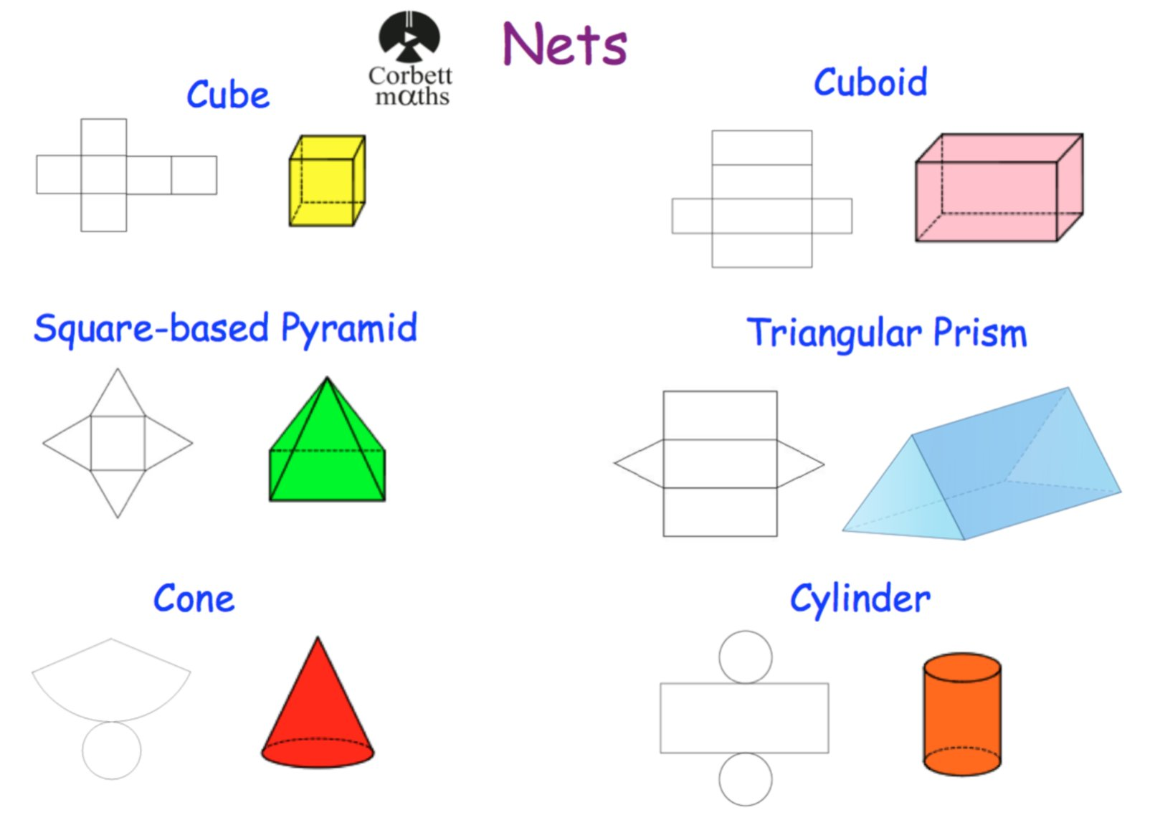
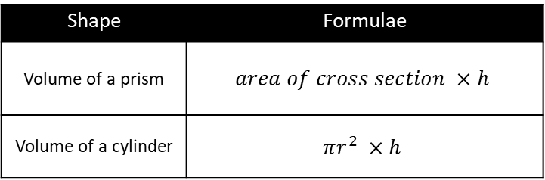

3-Dimensional Shapes
Pythagoras’ Theorem
Shape | Formulae
Volume of a prism | $$area of cross section ×h$$
Volume of a cylinder | $$πr^{2} ×h$$
Side a
Hypotenuse
Side b
$a$² $+$ $b$² $=$ hyp²
Notes:
Year 9 only

Slide 11
Revision List
Make sure you have your Dr Frost key skills list!
Subject: Maths
Topic | ☺ | 😐 | ☹ | Revised?

Slide 12
How to Revise for Science
Use the video to make notes on how best to revise for this subject.
1.
2.
3.

Slide 13
Year 9 Revision Topics
DNA Respiration Changes of State Gases in the atmosphere Reactivity of metals Global Warming Convection Lab equipment The digestive system Metals & their uses Insulation Gravitational Potential Energy Elements & Compounds – Properties Circuit Symbols Parallel and Series Circuits Photosynthesis Acids & Metal Salts Calculating Speed
Science

Slide 14
Revision List
Subject: Science
Topic | ☺ | 😐 | ☹ | Revised?

Slide 15
How to Revise for RE
Use the video to make notes on how best to revise for this subject.
1.
2.
3.

Slide 16
Year 9 revision list
Key facts about Buddhism and Christianity
The Abrahamic faiths and all associated key terms
Morality – absolute, relative
The ways people can believe in God
Parables
Teleological
Stewardship and dominion
Ahimsa
Cultural heritage
Persecution
Genocide
People: Martin Luther King Jr, Oscar Romero, Jehovah
Secularism
Where Jainism comes from
Islam: 5 pillars, Islamic art, Haram, Pilgrimage
Human rights relating to religion
RE

Slide 17
Revision List
Subject: RE
Topic | ☺ | 😐 | ☹ | Revised?

Slide 18
How to Revise for French
Use the video to make notes on how best to revise for this subject.
1.
2.
3.

Slide 19
Year 9
Revise the vocab sheet you have been given in lessons.
Plus:
Unit 1 – Describing myself - Describing myself, age, birthday, physical description, personality description, family, opinions
Unit 2 – Describing family members – avoir and etre, ER verbs
Unit 3 – Sports and hobbies – jouer and faire, opinions plus infinitives, time indicators
Unit 4 – School life – school facilities, subjects, teachers, opinions and reasons, jobs and future plans
Unit 5 – Where I live – describing towns and where you would like to live in the future
Unit 6 – Food – giving opinions of food with reasons, describing healthy lifestyles
Unit 7 – Holidays – countries, activities on holiday, past and future tenses
Unit 8 – Festivals – dates, festivals, past and future tenses
+ intensifiers, time indicators, complex opinions
French

Slide 20
Revision List
Subject: French
Topic | ☺ | 😐 | ☹ | Revised?

Slide 21
How to Revise for History
Use the video to make notes on how best to revise for this subject.
1.
2.
3.

Slide 22
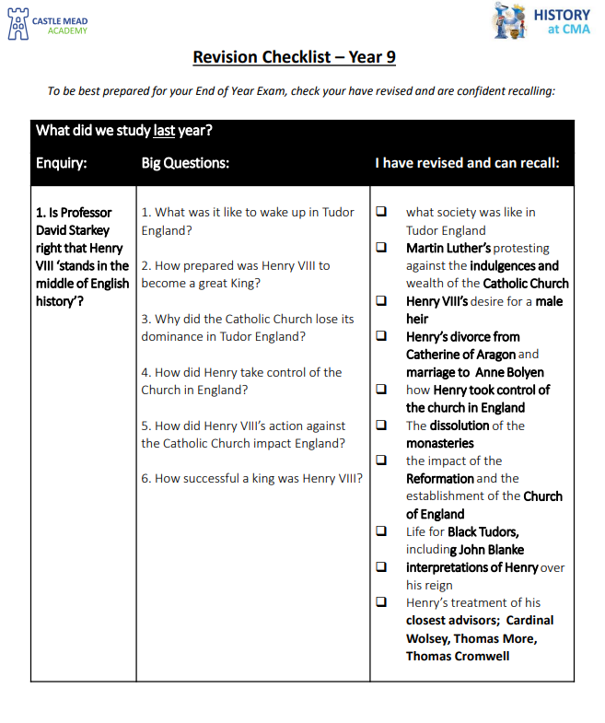
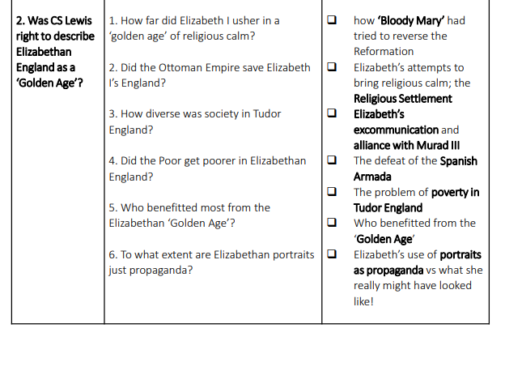

Slide 23
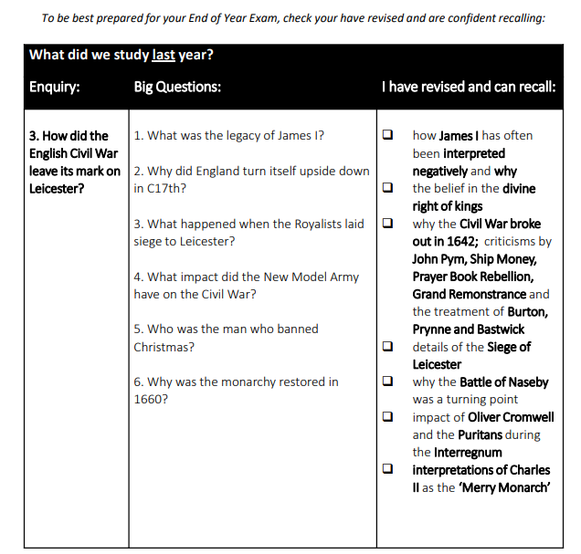
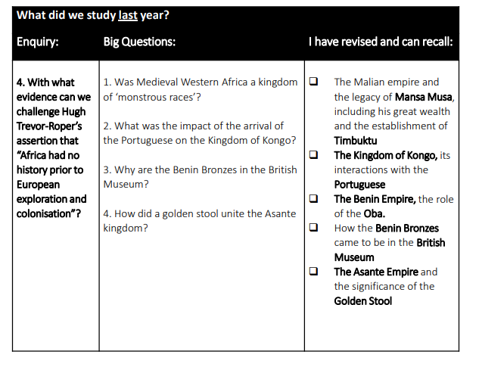

Slide 24
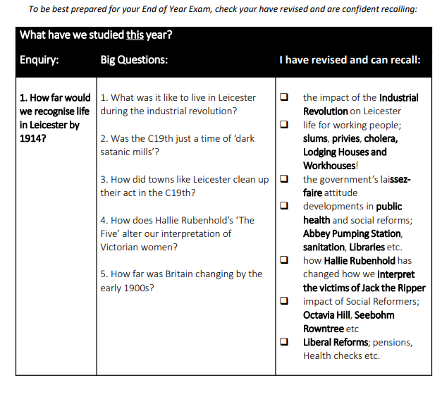
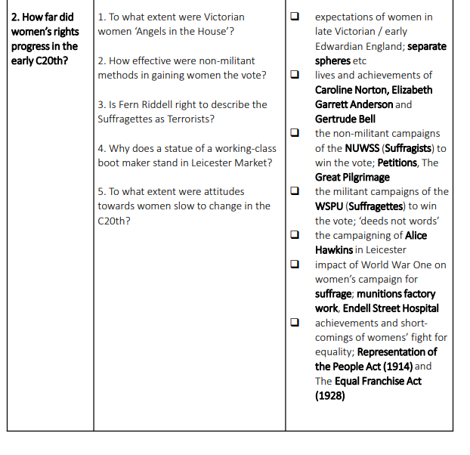

Slide 25
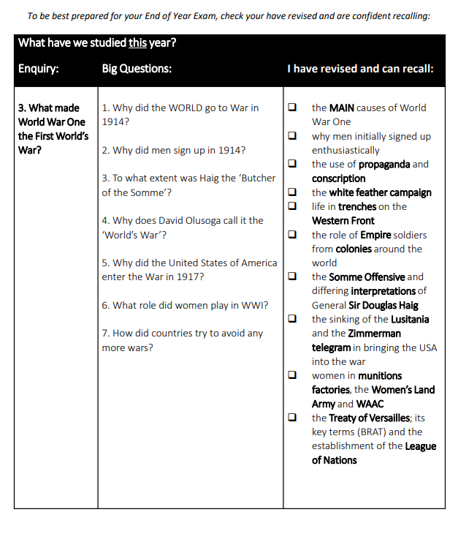
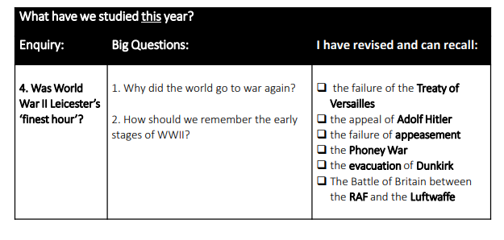

Slide 26
Revision List
Subject: History
Topic | ☺ | 😐 | ☹ | Revised?

Slide 27
How to Revise for Geography
Use the video to make notes on how best to revise for this subject.
1.
2.
3.

Slide 29
Revision List
Subject: Geography
Add the topics from the checklist provided
Topic | ☺ | 😐 | ☹ | Revised?

Slide 30
How to Revise for Design Technology
Use the video to make notes on how best to revise for this subject.
1.
2.
3.

Slide 31
Year 9
Product Design
Timbers
Polymers
Electronics – inputs & outputs
CAD/CAM
Technical drawing
Techsoft
Textiles
Lino printing
Positive and Negative shape
Dyeing methods
Fabrics and fibres
Seams and joining techniques
Annotation in design
Food
Food science
Cooking techniques
Function of ingredients
Design Technology

Slide 32
Revision List
Subject: Design Technology
Topic | ☺ | 😐 | ☹ | Revised?

Slide 33
How to Revise for Computer Science
Use the video to make notes on how best to revise for this subject.
1.
2.
3.

Slide 34
Computer systems:
Last Year:
What are the two types of computer? ​
Which two elements make up a computer system? ​
How does the CPU (Central Processing Unit) process instructions? ​
What are the two main tiers of storage?
What are the two types of software?
This Year:
What do input, output and storage devices do to data?
Why do computers need primary storage?
How do clock speed and number of cores affect CPU performance?
What does the operating system help the user to do?
What does utility software do?
Programming:
Last Year:
How do we use IF statements?
What is a variable and how do we use it in programming?
You may be asked to create programs on make code or rapid router using:
Sequence
Selection - IF / ELIF / ELSE
Iteration – FOR / WHILE
This year:
Python
  Data types
  How to output
  How to assign variables
  How to ask the user for an input
  IF statements
Computer Science

Slide 35
Algorithms:
Last Year:
The three basic programming constructs
  Sequence
  Iteration
    Count controlled loop (for loop)
    Condition controlled loop (while loop)
  Selection
The difference between algorithms, pseudocode and programs
Reading and understanding block code
Reading and understanding pseudocode
Translating block code to pseudocode
This year:
What is a flow diagram?
How can we show sequence, iteration and selection in flow diagrams?
How can we translate flow diagrams to block code?
How can we translate block code to flow diagrams?
Data representation:
Last Year:
Binary and decimal numbers
Why computers use binary
Binary to decimal conversion
Decimal to binary conversion
Binary addition
Character representation
  What bit depth is
    The impact of increasing or decreasing bit depth on the number of characters that can be represented
  Character sets and how the computer uses them
  ASCII character set
This year:
Converting between file sizes
Hexadecimal numbers
Image representation:
  What is a pixel? What is colour depth?
  Calculating the file size of images using:
    File size in bits = image width in pixels x image height in pixels x colour depth
  What is metadata?

Slide 36
Revision List
Subject: Computer Science
Topic | ☺ | 😐 | ☹ | Revised?

Slide 37
How to Revise for Drama
Use the video to make notes on how best to revise for this subject.
1.
2.
3.

Slide 38
Drama Revision List – Year 9
Drama Basics:
- Rules of the theatre
- Non-naturalistic techniques
- Vocal and Physical skills
Year 8 Topics:
- Theatre in Education
- Pantomime
- Naturalism
Year 9 Topics:
- Brechtian Theatre
- Noughts and Crosses
- Live Theatre Review

Slide 39
Revision List
Subject: Drama
Topic | ☺ | 😐 | ☹ | Revised?

Slide 40
How to Revise for Music
Use the video to make notes on how best to revise for this subject.
1.
2.
3.

Slide 41
Revision List
Unit 1: Keyboard Skills: Film music
Unit 2: Performance Skills: Reggae
Subject: Music
Topic | ☺ | 😐 | ☹ | Revised?

Slide 42
Revision Space

Slide 43
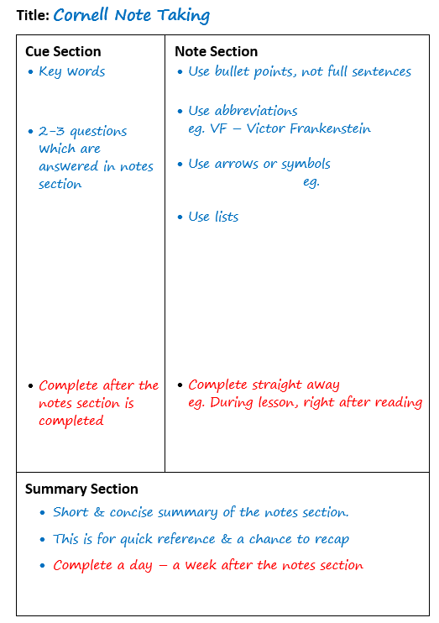

Slide 44


Slide 51
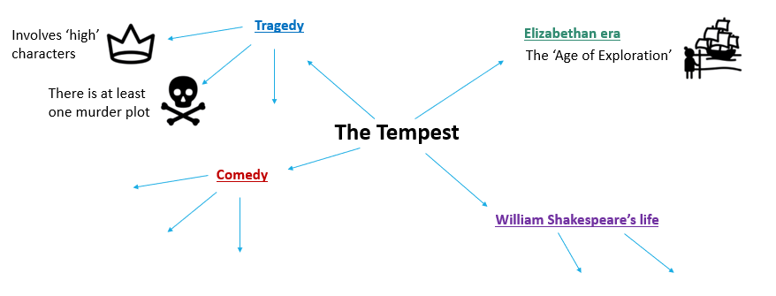
Mind map Example

Slide 52
Subject:
Topic:

Slide 53
Subject:
Topic:

Slide 54
Subject:
Topic:

Slide 55
Subject:
Topic:

Slide 56
Subject:
Topic:

