Slide 1
Do Now Task
Year 8
Notes:
Tutors: Do not take questi

Slide 2
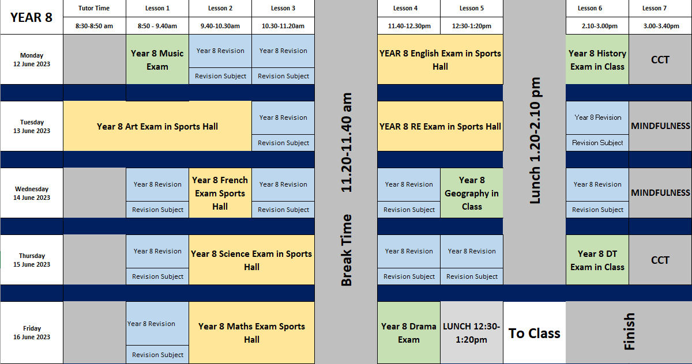
Summer End of Year Exam- Timetable
Add in which subjects you will revise for in your revision sessions.
Ensure you bring the correct revision materials with you.
You will also have your exam timetable printed which has your seat number on for each exam.
You will have a mixture of exams in the Sports Hall, classroom and revision sessions.
Notes:
Tutors: Do not take questi

Slide 3
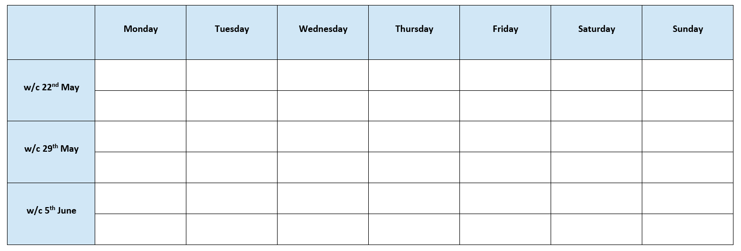
Revision Timetable
Add all of your subjects into the revision timetable below to support with your revision over the next few weeks.

Slide 4
Looking after yourself during Exam Week
End of year exams can be stressful, but don’t worry, it is normal to feel some nerves when you have exams approaching.
There are lots of different ways to prevent stress:
Exercise
Exercise reduces stress and produces endorphins (chemicals in your brain that make you feel good!).
Action: Go outside for a walk or do an indoor workout
2. Sleep
It is important that you get a good night sleep to help your brain to work!
Action: Get at least 8 hours of sleep a night.
3. Mindfulness
Sometimes we need a break from revising and doing some mindfulness activities can help declutter our brains.
Action: Complete some pages in your mindfulness booklets.
4. Talk to someone
If you feel too stressed, remember, you are not alone so talk to someone.
Action: Speak to your friends, families or member of staff if you are feeling really stressed.

Slide 5
How to Revise for English
Use the video to make notes on how best to revise for this subject.
1.
2.
3.

Slide 6
You will need to know:
The key conventions (what we can expect of) and structure of a tragedy and how audiences may respond to them
Key techniques used in the texts we have studied (e.g foreshadowing, metaphor, rhetorical questions etc)
Key contextual details about the eras of the texts we’ve studied (What the Victorian era was like for example)
The conventions of different forms of literature we have studied (Letters, tragedies, comedies, novels etc)
The key ideas, themes and messages of the texts we have studied
Key elements of rhetoric
The elements of grammar we have focused on in Language (including apostrophes, connectives, sentences that begin with a part that tells us when or where something happened)
You will need to know how to
Write about your first impressions of a poem
Write an analytical paragraph (how it is ordered; how you write a topic sentence)
Identify rhetoric in a text and comment on its impact
Write a persuasive letter
English

Slide 7
Revision List
You will need to bring your English books as well to revise.
Subject: English
Topic | ☺ | 😐 | ☹ | Revised?

Slide 8
How to Revise for Maths
Use the video to make notes on how best to revise for this subject.
1.
2.
3.

Slide 9
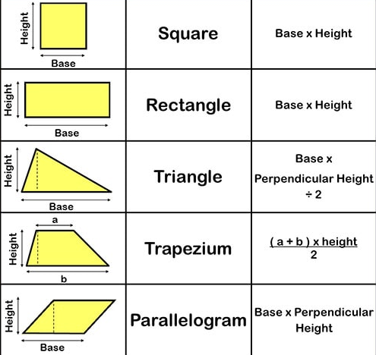
Castle Mead Mathematics – Facts to know
Square Numbers
$$1^{2}=1$$ $$2^{2}=4$$ $$3^{2}=9$$ $$4^{2}=16$$ $$5^{2}=25$$ $$6^{2}=36$$ $$7^{2}=49$$ $$8^{2}=64$$ $$9^{2}=81$$ $${10}^{2}=100$$ $${11}^{2}=121$$ $${12}^{2}=144$$ $${13}^{2}=169$$ $${14}^{2}=196$$ $${15}^{2}=225$$
Cube Numbers
$$1^{3}= 1$$ $$2^{3}= 8$$ $$3^{3}=27$$ $$4^{3}=64$$ $5^{3}=1$25 $${10}^{3}=1000$$
Inverse Operations
$$+ and −$$ $$×and ÷$$ Square and square root
Fraction | Decimal | Percentage
$$\frac{1}{100}$$ | $$0.01$$ | $$1\%$$
$$\frac{1}{10}$$ | $$0.1$$ | $$10\%$$
$$\frac{1}{5}$$ | $$0.2$$ | $$20\%$$
$$\frac{1}{4}$$ | $$0.25$$ | $$25\%$$
$$\frac{1}{3}$$ | $$0.\dot{3}$$ | $$33.\dot{3\%}$$
$$\frac{1}{2}$$ | $$0.5$$ | $$50\%$$
$$\frac{1}{1}$$ | $$1$$ | $$100\%$$
Prime Numbers (exactly two factors)
$2, 3, 5, 7, 11, 13, 17, 19, 23, 29, 31$…
Product , Sum, Difference
$factor×factor=product$
$$number+number=sum$$
$$number −number=difference$$
Algebra
Simplify – add and subtract like terms $$3x−2y+4x+5y=7x+3y$$
Factorise – remove the common factor, write in brackets $$8x+12y=4(2x+3y)$$
Expand – multiply everything inside the brackets by the factor outside $$7(2x−3y)=14x−21y$$
Substitute – replace the variable with a value and calculate $$if a=5$$ $$4a−2=4×5−2$$ $$=18$$
Shape measurements
Perimeter length around the edge ADD units – mm, cm, m …
Area 2-dimensional space MULTIPLY 2-dimensions units² – mm², cm², m² …
Volume 3-dimensional space MULTIPLY 3-dimensions units³– mm³, cm³, m³ …
Area of 2-dimensional shapes
Negative Numbers add & subtract | Negative Numbers $×$ & $÷$
Adding a negative number has the same result as subtracting a positive number $5+\left(−2\right)=3$ and $5−2=3$ | negative $×$negative $=$ positive positive $×$negative = negative negative $×$positive = negative
Subtracting a negative has the same result as adding a positive $5−\left(−2\right)=7$ and $5+2=7$ | negative $÷$negative $=$ positive positive $÷$negative = negative negative $÷$positive = negative

Slide 10
Revision List
Make sure you have your Dr Frost key skills list!
Subject: Maths
Topic | ☺ | 😐 | ☹ | Revised?

Slide 11
How to Revise for Science
Use the video to make notes on how best to revise for this subject.
1.
2.
3.

Slide 12
Year 8 Revision Topics
Periodic table Word equations Differences between elements, compounds & mixtures Structure of the atom The digestive system Enzymes & Protein Testing for foods Types of pathogens Differences between aerobic and anaerobic respiration Conduction & Radiation Insulation & Reducing Heat Loss Circuit Definitions Adaptations in plants and animals Cells → Organs Specialised Cells Microscopes & Magnification Renewable and Non-Renewable Energy
Science

Slide 13
Revision List
Subject: Science
Topic | ☺ | 😐 | ☹ | Revised?

Slide 14
How to Revise for RE
Use the video to make notes on how best to revise for this subject.
1.
2.
3.

Slide 15
Year 8 revision list
Key facts around Buddhism, Christianity and Islam
The Abrahamic faiths unit
Absolute & relative morality
Secularism
The ways in which someone can believe in God
The Good Samaritan
The Parable of the Talents
Islam: Judgement day, paradise and hell, 5 pillars, pilgrimage
How do Science and religion conflict?
How does religion unite people today?
What do people believe about looking after the planet?
RE

Slide 16
Revision List
Subject: RE
Topic | ☺ | 😐 | ☹ | Revised?

Slide 17
How to Revise for French
Use the video to make notes on how best to revise for this subject.
1.
2.
3.

Slide 18
Year 8
Revise the vocab sheet you have been given in lessons.
Plus:
Unit 1 – Describing myself - Describing myself, age, birthday, physical description, personality description, family, opinions
Unit 2 – Describing family members – avoir and etre, ER verbs
Unit 3 – Sports and hobbies – jouer and faire, opinions plus infinitives
Unit 4 – School life – school facilities, giving opinions of subjects and teachers with reasons, jobs and future plans
+ intensifiers, time indicators, complex opinions
French

Slide 19
Revision List
Subject: French
Topic | ☺ | 😐 | ☹ | Revised?

Slide 20
How to Revise for History
Use the video to make notes on how best to revise for this subject.
1.
2.
3.

Slide 21
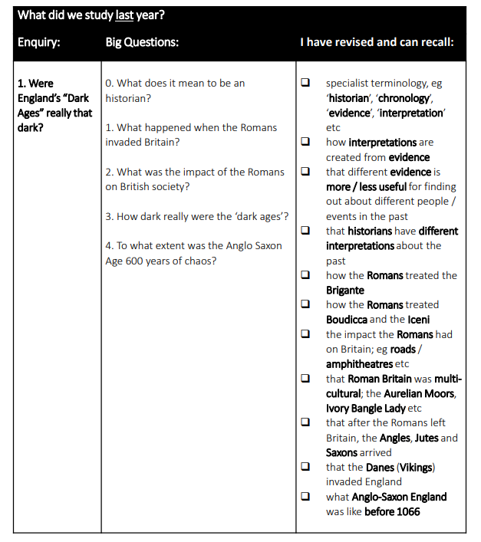

Slide 22
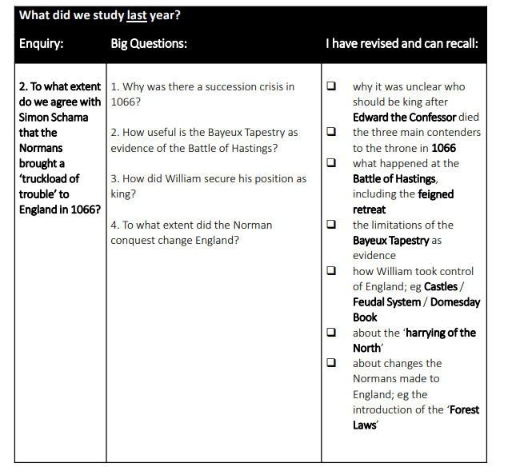

Slide 23
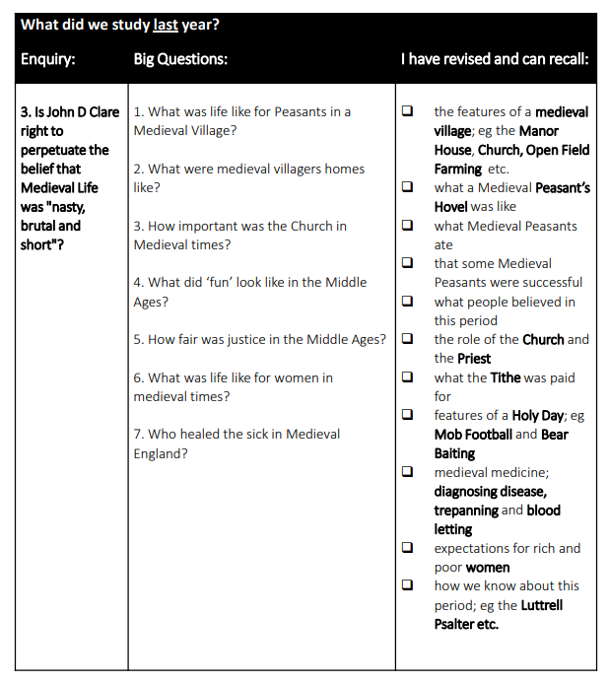
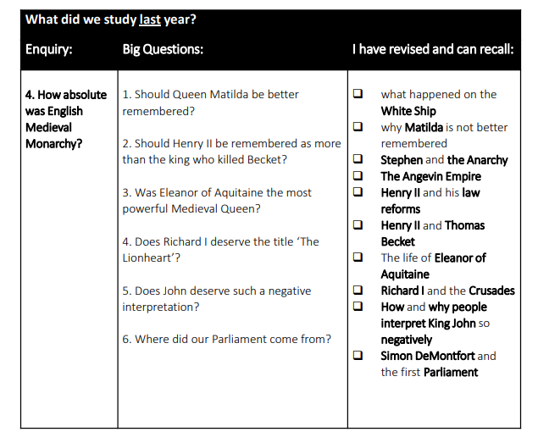

Slide 24
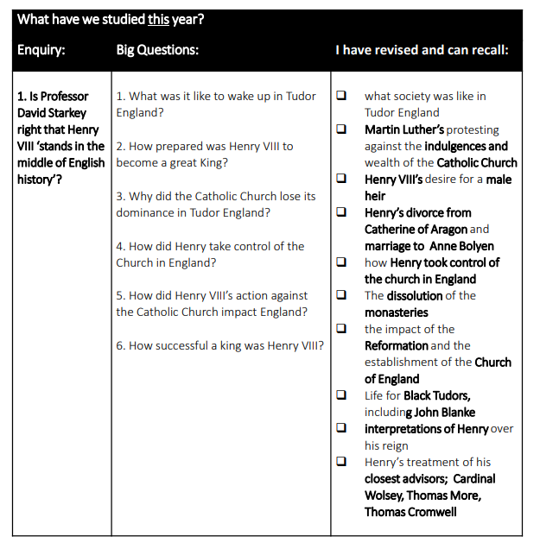
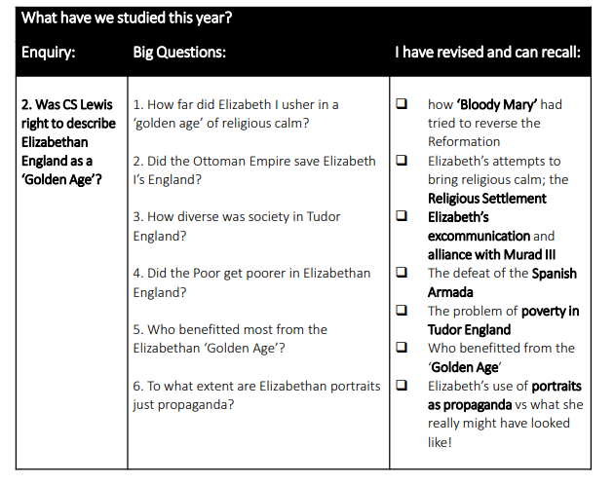

Slide 25
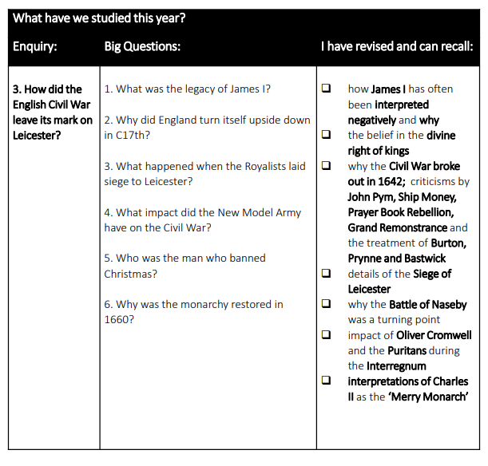

Slide 26
Revision List
Subject: History
Topic | ☺ | 😐 | ☹ | Revised?

Slide 27
How to Revise for Geography
Use the video to make notes on how best to revise for this subject.
1.
2.
3.

Slide 28
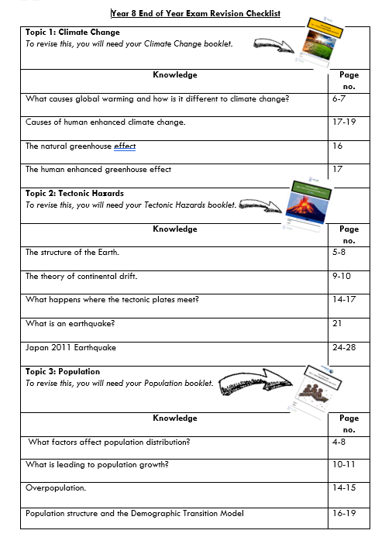

Slide 29
Revision List
Subject: Geography
Add the topics from the checklist provided
Topic | ☺ | 😐 | ☹ | Revised?

Slide 30
How to Revise for Design Technology
Use the video to make notes on how best to revise for this subject.
1.
2.
3.

Slide 31
Product Design
CAD/CAM
Techsoft
Polymers – thermoforming and thermosetting
Drawing techniques – oblique drawing
Textiles
Recycling in textiles
Sustainability
Surface decoration
Dyeing methods
Logo design
Food
Making the right food choices
Food safety
Personal hygiene
Design Technology

Slide 32
Revision List
Subject: Design Technology
Topic | ☺ | 😐 | ☹ | Revised?

Slide 33
How to Revise for Computer Science
Use the video to make notes on how best to revise for this subject.
1.
2.
3.

Slide 34
Computer systems:
Last Year:
What are the two types of computer? ​
Which two elements make up a computer system? ​
How does the CPU (Central Processing Unit) process instructions? ​
What are the two main tiers of storage?
What are the two types of software?
This Year:
What do input, output and storage devices do to data?
Why do computers need primary storage?
How do clock speed and number of cores affect CPU performance?
What does the operating system help the user to do?
What does utility software do?
Programming:
Last Year:
How do we use IF statements?
What is a variable and how do we use it in programming?
You may be asked to create programs on make code or rapid router using:
Sequence
Selection - IF / ELIF / ELSE
Iteration – FOR / WHILE
This year:
Python
Data types
How to output
How to assign variables
How to ask the user for an input
IF statements
Computer Science

Slide 35
Algorithms: Last Year:
The three basic programming constructs
Sequence
Iteration
Count controlled loop (for loop)
Condition controlled loop (while loop)
Selection
The difference between algorithms, pseudocode and programs
Reading and understanding block code
Reading and understanding pseudocode
Translating block code to pseudocode
This year:
What is a flow diagram?
How can we show sequence, iteration and selection in flow diagrams?
How can we translate flow diagrams to block code?
How can we translate block code to flow diagrams?
Data representation:
Last Year:
Binary and decimal numbers
Why computers use binary
Binary to decimal conversion
Decimal to binary conversion
Binary addition
Character representation
What bit depth is
The impact of increasing or decreasing bit depth on the number of characters that can be represented
Character sets and how the computer uses them
ASCII character set
This year:
Converting between file sizes
Hexadecimal numbers
Image representation:
What is a pixel? What is colour depth?
Calculating the file size of images using:
File size in bits = image width in pixels x image height in pixels x colour depth
What is metadata?

Slide 36
Revision List
Subject: Computer Science
Topic | ☺ | 😐 | ☹ | Revised?

Slide 37
How to Revise for Drama
Use the video to make notes on how best to revise for this subject.
1.
2.
3.

Slide 38
Drama Basics: - Rules of the theatre - Non-naturalistic techniques - Vocal and Physical skills
Year 7 Topics: - Theatre through the Ages - Devising - Introduction to scripts
Year 8 Topics: - Theatre in Education - Pantomime - Live Theatre Review

Slide 39
Revision List
Subject: Drama
Topic | ☺ | 😐 | ☹ | Revised?

Slide 40
How to Revise for Music
Use the video to make notes on how best to revise for this subject.
1.
2.
3.

Slide 41
Revision List
Subject: Music
Unit 1 – Composition Skills: Blues Lyrics
Unit 2 – Guitar Skills: 12 Bar Blues
Unit 3 – Keyboard Skills: Jazz Improvisation
Unit 4 – Singing Skills: Vocals Ancient & Modern
Topic | ☺ | 😐 | ☹ | Revised?

Slide 42
Revision Space

Slide 43
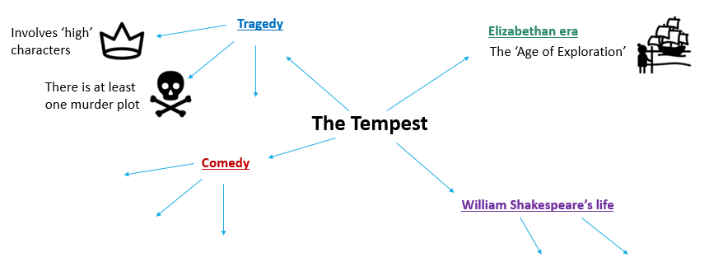
Mind map Example

Slide 44
Subject:
Topic:

Slide 45
Subject:
Topic:

Slide 46
Subject:
Topic:

Slide 47
Subject:
Topic:

Slide 48
Subject:
Topic:

