Slide 1
Do Now Task
Year 7
Notes:
Tutors: Do not take questi

Slide 2
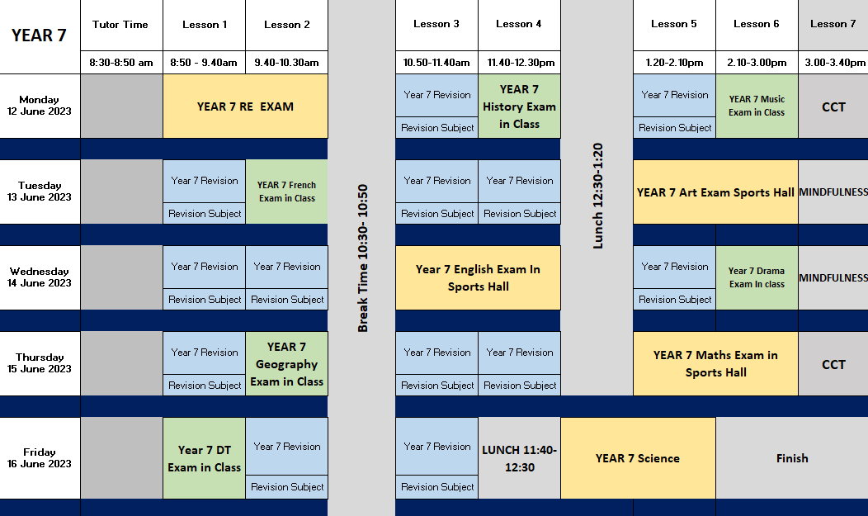
Summer End of Year Exam- Timetable
Add in which subjects you will revise for in your revision sessions.
Ensure you bring the correct revision materials with you.
You will also have your exam timetable printed which has your seat number on for each exam.
You will have a mixture of exams in the Sports Hall, classroom and revision sessions.
Notes:
Tutors: Do not take questi

Slide 3
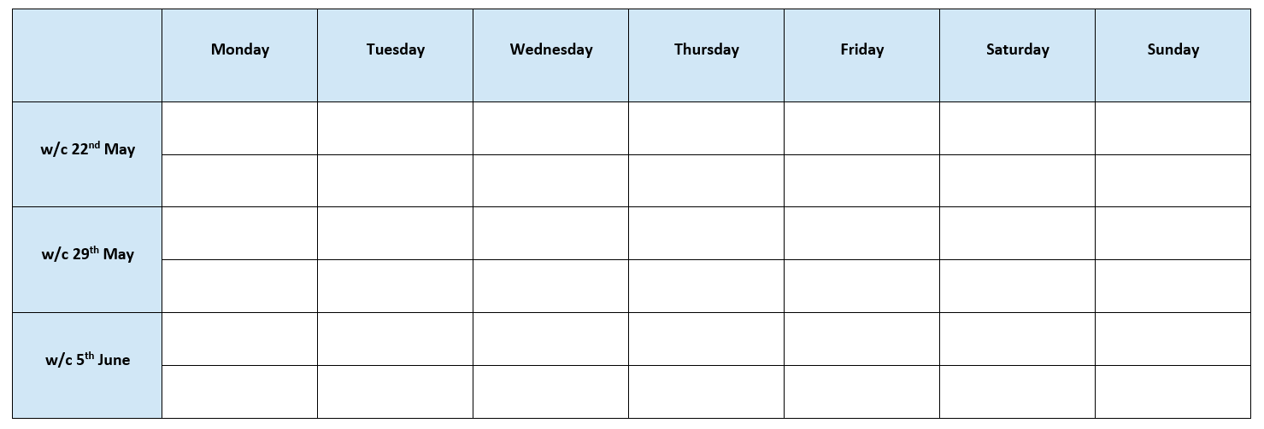
Revision Timetable
Add all of your subjects into the revision timetable below to support with your revision over the next few weeks.

Slide 4
Looking after yourself during Exam Week
End of year exams can be stressful, but don’t worry, it is normal to feel some nerves when you have exams approaching.
There are lots of different ways to prevent stress:
Exercise
Exercise reduces stress and produces endorphins (chemicals in your brain that make you feel good!).
Action: Go outside for a walk or do an indoor workout
2. Sleep
It is important that you get a good night sleep to help your brain to work!
Action: Get at least 8 hours of sleep a night.
3. Mindfulness
Sometimes we need a break from revising and doing some mindfulness activities can help declutter our brains.
Action: Complete some pages in your mindfulness booklets.
4. Talk to someone
If you feel too stressed, remember, you are not alone so talk to someone.
Action: Speak to your friends, families or member of staff if you are feeling really stressed.

Slide 5
How to Revise for English
Use the video to make notes on how best to revise for this subject.
1.
2.
3.

Slide 6
You will need to know:
The conventions of the different forms and genres we’ve studied this year (letters, tragedies, comedies, novels etc)
Key contextual information about the texts we’ve studied this year (What the Victorian era was like for example)
The key vocabulary you’ve learned in Reading for Pleasure and Literature
The key skills we’ve focused on in Language (for example, what makes a complete sentence, informal and formal writing, the past simple, how letters are laid out, what tone is etc.)
You will need to know how to:
Explode a quotation (analyse the language that a writer has used and why they have used it)
Write an analytical paragraph (how it is ordered; how you write a topic sentence)
Write a formal letter
English

Slide 7
Revision List
You will need to bring your English books as well to revise.
Subject: English
Topic | ☺ | 😐 | ☹ | Revised?

Slide 8
How to Revise for Maths
Use the video to make notes on how best to revise for this subject.
1.
2.
3.

Slide 9
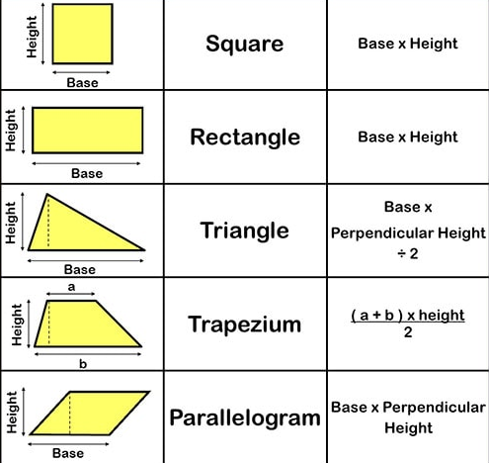
Castle Mead Mathematics – Facts to know
Square Numbers
$$1^{2}=1$$ $$2^{2}=4$$ $$3^{2}=9$$ $$4^{2}=16$$ $$5^{2}=25$$ $$6^{2}=36$$ $$7^{2}=49$$ $$8^{2}=64$$ $$9^{2}=81$$ $${10}^{2}=100$$ $${11}^{2}=121$$ $${12}^{2}=144$$ $${13}^{2}=169$$ $${14}^{2}=196$$ $${15}^{2}=225$$
Cube Numbers
$$1^{3}= 1$$ $$2^{3}= 8$$ $$3^{3}=27$$ $$4^{3}=64$$ $5^{3}=1$25 $${10}^{3}=1000$$
Inverse Operations
$$+ and −$$ $$×and ÷$$ Square and square root
Fraction | Decimal | Percentage
$$\frac{1}{100}$$ | $$0.01$$ | $$1\%$$
$$\frac{1}{10}$$ | $$0.1$$ | $$10\%$$
$$\frac{1}{5}$$ | $$0.2$$ | $$20\%$$
$$\frac{1}{4}$$ | $$0.25$$ | $$25\%$$
$$\frac{1}{3}$$ | $$0.\dot{3}$$ | $$33.\dot{3\%}$$
$$\frac{1}{2}$$ | $$0.5$$ | $$50\%$$
$$\frac{1}{1}$$ | $$1$$ | $$100\%$$
Prime Numbers (exactly two factors)
$2, 3, 5, 7, 11, 13, 17, 19, 23, 29, 31$…
Product , Sum, Difference
$factor×factor=product$
$$number+number=sum$$
$$number −number=difference$$
Algebra
$$x+x+x≡3x$$ $$5×x≡5x$$ $$y×x×4≡4xy$$ $$x÷6≡\frac{x}{6}$$ $$x×x≡x^{2}$$
Solve Equations Use inverse operations to find the value of the variable
Simplify – add and subtract like terms $$3x−2y+4x+5y=7x+3y$$
Substitute – replace the variable with a value and calculate $$if a=5$$ $$4a−2=4×5−2$$ $$=18$$
Shape measurements
Perimeter length around the edge ADD units – mm, cm, m …
Area 2-dimensional space MULTIPLY 2-dimensions units² – mm², cm², m² …
Volume 3-dimensional space MULTIPLY 3-dimensions units³– mm³, cm³, m³ …
Area of 2-dimensional shapes
Negative Numbers add & subtract | Negative Numbers $×$ & $÷$
Adding a negative number has the same result as subtracting a positive number $5+\left(−2\right)=3$ and $5−2=3$ | negative $×$negative $=$ positive positive $×$negative = negative negative $×$positive = negative
Subtracting a negative has the same result as adding a positive $5−\left(−2\right)=7$ and $5+2=7$ | negative $÷$negative $=$ positive positive $÷$negative = negative negative $÷$positive = negative

Slide 10
Revision List
Make sure you have your Dr Frost key skills list!
Subject: Maths
Topic | ☺ | 😐 | ☹ | Revised?

Slide 11
How to Revise for Science
Use the video to make notes on how best to revise for this subject.
1.
2.
3.

Slide 12
Year 7 Revision Topics
Plant and Animal Cell structures Adaptations of sperm cells Functions of cell organelles Particle diagrams for states of matter Energy stores Renewable energy resources Resultant forces Force diagrams Periodic table Word equations Differences between elements, compounds & mixtures
Science

Slide 13
Revision List
Subject: Science
Topic | ☺ | 😐 | ☹ | Revised?

Slide 14
How to Revise for RE
Use the video to make notes on how best to revise for this subject.
1.
2.
3.

Slide 15
Year 7 revision list
Key facts about Islam, Christianity, Hinduism, Buddhism
The Abrahamic faiths unit
Purgatory
10 commandments
Islamic day of judgement, paradise and Hell
Rites of passage in Christianity
Why are sacred places important?
How do festivals hold meaning for believers?
What do people believe about life after death?
RE

Slide 16
Revision List
Subject: RE
Topic | ☺ | 😐 | ☹ | Revised?

Slide 17
How to Revise for French
Use the video to make notes on how best to revise for this subject.
1.
2.
3.

Slide 18
French
Year 7
Revise the vocab sheet you have been given in lessons.
Plus:
Units 1 and 2 – Describing myself and my family, animals, colours, numbers, physical description, personality description
Unit 3 – Sports and hobbies – jouer and faire, opinions plus infinitives
+ intensifiers, time indicators, complex opinions

Slide 19
Revision List
Subject: French
Topic | ☺ | 😐 | ☹ | Revised?

Slide 20
How to Revise for History
Use the video to make notes on how best to revise for this subject.
1.
2.
3.

Slide 21
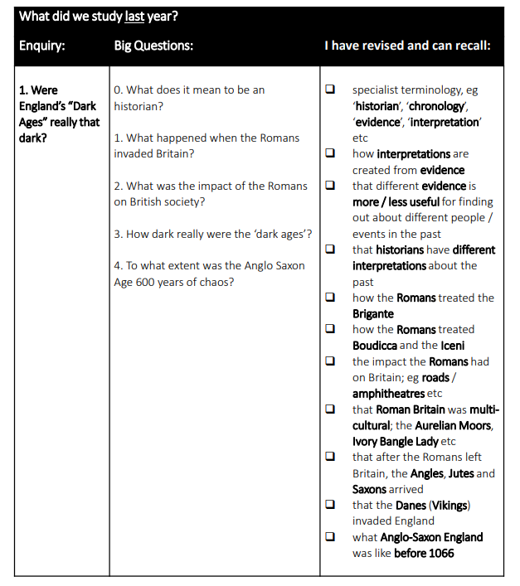

Slide 22
Revision Checklist – Year 7
To be best prepared for your End of Year Exam, check your have revised and are confident recalling:
What have we studied this year?
Enquiry: | Big Questions: | I have revised and can recall:
1. Were England’s “Dark Ages” really that dark? | 0. What does it mean to be an historian? 1. What happened when the Romans invaded Britain? 2. What was the impact of the Romans on British society? 3. How dark really were the ‘dark ages’? 4. To what extent was the Anglo Saxon Age 600 years of chaos? | specialist terminology, eg ‘historian’, ‘chronology’, ‘evidence’, ‘interpretation’ etc how interpretations are created from evidence that different evidence is more / less useful for finding out about different people / events in the past that historians have different interpretations about the past how the Romans treated the Brigante how the Romans treated Boudicca and the Iceni the impact the Romans had on Britain; eg roads / amphitheatres etc that Roman Britain was multi-cultural; the Aurelian Moors, Ivory Bangle Lady etc that after the Romans left Britain, the Angles, Jutes and Saxons arrived that the Danes (Vikings) invaded England what Anglo-Saxon England was like before 1066

Slide 23
To be best prepared for your End of Year Exam, check your have revised and are confident recalling:
What have we studied this year?
Enquiry: | Big Questions: | I have revised and can recall:
2. To what extent do we agree with Simon Schama that the Normans brought a ‘truckload of trouble’ to England in 1066? | 1. Why was there a succession crisis in 1066? 2. How useful is the Bayeux Tapestry as evidence of the Battle of Hastings? 3. How did William secure his position as king? 4. To what extent did the Norman conquest change England? | why it was unclear who should be king after Edward the Confessor died the three main contenders to the throne in 1066 what happened at the Battle of Hastings, including the feigned retreat the limitations of the Bayeux Tapestry as evidence how William took control of England; eg Castles / Feudal System / Domesday Book about the ‘harrying of the North’ about changes the Normans made to England; eg the introduction of the ‘Forest Laws’

Slide 24
To be best prepared for your End of Year Exam, check your have revised and are confident recalling:
What have we studied this year?
Enquiry: | Big Questions: | I have revised and can recall:
3. Is John D Clare right to perpetuate the belief that Medieval Life was "nasty, brutal and short"? | 1. What was life like for Peasants in a Medieval Village? 2. What were medieval villagers homes like? 3. How important was the Church in Medieval times? 4. What did ‘fun’ look like in the Middle Ages? 5. How fair was justice in the Middle Ages? 6. What was life like for women in medieval times? 7. Who healed the sick in Medieval England? | the features of a medieval village; eg the Manor House, Church, Open Field Farming etc. what a Medieval Peasant’s Hovel was like what Medieval Peasants ate that some Medieval Peasants were successful what people believed in this period the role of the Church and the Priest what the Tithe was paid for features of a Holy Day; eg Mob Football and Bear Baiting medieval medicine; diagnosing disease, trepanning and blood letting expectations for rich and poor women how we know about this period; eg the Luttrell Psalter etc.

Slide 25
To be best prepared for your End of Year Exam, check your have revised and are confident recalling:
What have we studied this year?
Enquiry: | Big Questions: | I have revised and can recall:
4. How absolute was English Medieval Monarchy? | 1. Should Queen Matilda be better remembered? 2. Should Henry II be remembered as more than the king who killed Becket? 3. Was Eleanor of Aquitaine the most powerful Medieval Queen? | what happened on the White Ship why Matilda is not better remembered Stephen and the Anarchy The Angevin Empire Henry II and his law reforms Henry II and Thomas Becket The life of Eleanor of Aquitaine

Slide 26
Revision List
Subject: History
Topic | ☺ | 😐 | ☹ | Revised?

Slide 27
How to Revise for Geography
Use the video to make notes on how best to revise for this subject.
1.
2.
3.

Slide 28
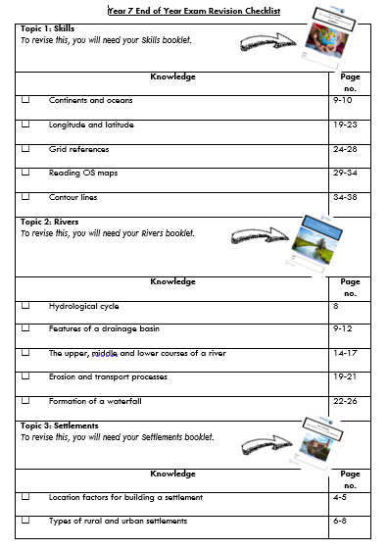

Slide 29
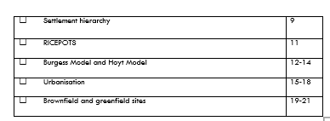

Slide 30
Revision List
Subject: Geography
Add the topics from the checklist provided
Topic | ☺ | 😐 | ☹ | Revised?

Slide 31
How to Revise for Design Technology
Use the video to make notes on how best to revise for this subject.
1.
2.
3.

Slide 32
Product Design
Timbers
3D drawing techniques
H&S in the work shop
ACCESS FM
Textiles
Fibres and fabrics
ACCESS FM
Parts of the machine
Designers
Food
Healthy eating
H&S in the kitchen
The eat well plate – carbohydrates, proteins, fruit and veg, fats and spreads, dairy
Design Technology

Slide 33
Revision List
Subject: Design Technology
Topic | ☺ | 😐 | ☹ | Revised?

Slide 34
How to Revise for Computer Science
Use the video to make notes on how best to revise for this subject.
1.
2.
3.

Slide 35
Computer systems:
What are the two types of computer? ​
Which two elements make up a computer system? ​
What are the two types of software?
How does the CPU (Central Processing Unit) process instructions? ​
What are the two main tiers of storage?
Programming:
How do we use IF statements?
What is a variable and how do we use it in programming?
You may be asked to create programs on make code or rapid router using:
Sequence
Selection - IF / ELIF / ELSE
Iteration – FOR / WHILE
Algorithms:
What are the three basic programming constructs?
What are the two loops in programming?
How to use selection in programming?
What is a flow diagram?
How can we show sequence, iteration and selection in flow diagrams?
How can we translate flow diagrams to block code?
How can we translate block code to flow diagrams?
Data representation:
Binary and decimal numbers
Why computers use binary
Binary to decimal conversion
Decimal to binary conversion
Binary addition
Character representation
What bit depth is
The impact of increasing or decreasing bit depth on the number of characters that can be represented
Character sets and how the computer uses them
ASCII character set
Computer Science

Slide 36
Revision List
Subject: Computer Science
Topic | ☺ | 😐 | ☹ | Revised?

Slide 37
How to Revise for Drama
Use the video to make notes on how best to revise for this subject.
1.
2.
3.

Slide 38
Drama Basics: - Rules of the theatre - Non-naturalistic techniques - Vocal and Physical skills
Year 7 Topics: - Theatre through the Ages - Devising - Introduction to scripts (The Wardrobe) - Live Theatre Review

Slide 39
Revision List
Subject: Drama
Topic | ☺ | 😐 | ☹ | Revised?

Slide 40
How to Revise for Music
Use the video to make notes on how best to revise for this subject.
1.
2.
3.

Slide 41
Revision List
Subject: Music
Unit 1a – Samba Instruments
Unit 1b – Beat & Rhythm
Unit 2 – Xylophone Skills: African Melodies
Unit 3 – Keyboard Skills: Ode to Joy
Topic | ☺ | 😐 | ☹ | Revised?

Slide 42
Revision Space

Slide 43
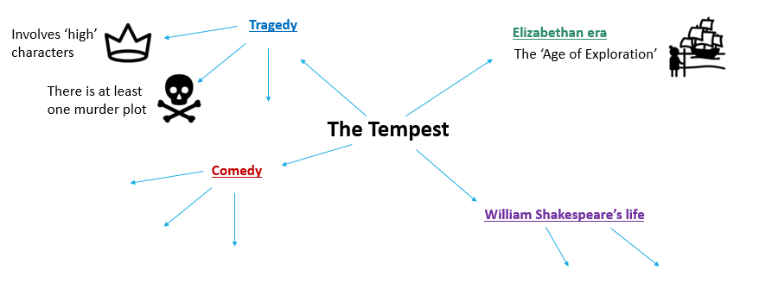
Mind map Example

Slide 44
Subject:
Topic:

Slide 45
Subject:
Topic:

Slide 46
Subject:
Topic:

Slide 47
Subject:
Topic:

Slide 48
Subject:
Topic:

