Slide 1
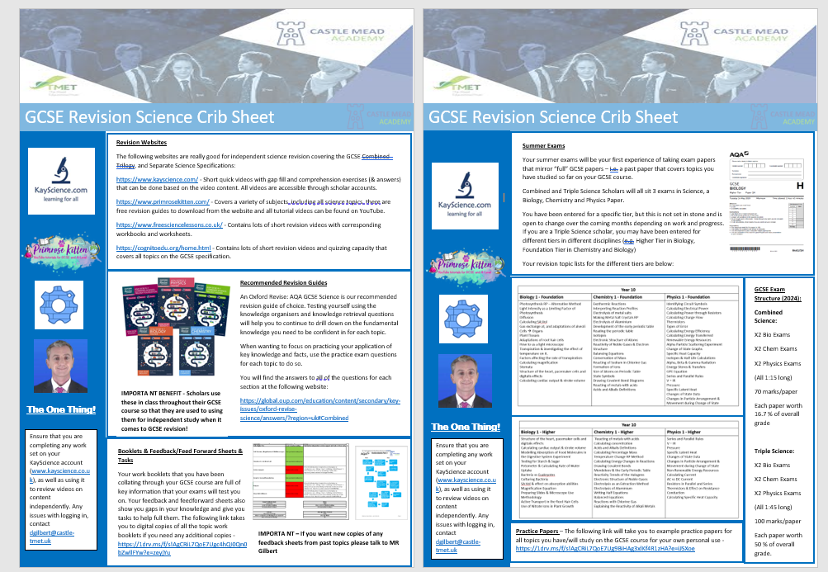
Please see the provided sheet…
How to revise for Science…

