Slide 1
GCSE Religious Education
What will the GCSE exam look like in Year 11
What are the demands of the course?
What will the summer mock exam look like?
How do scholars best revise for RE?

Slide 2
What does the exam look like?
3 exams:
Christianity – 1 hour
two of each of a 2, 5, 8 & 15 markers (one marking SPaG)
Buddhism – 1 hour
two of each of a 2, 5, 8 & 15 markers (NONE marking SPaG)
Themes – 2 hours
Four of each of a 2, 5, 8 & 15 markers (one marking SPaG)
Things to note:
Write in the paper.
Need to time themselves – a mark a minute
MUST check through their paper after – especially the SPaG questions
Current suggested dates:
9th May
16th May
7th June

Slide 3
What are the demands of the course?
They need to use sources of wisdom
For religions, this needs to be sacred texts, creeds and writings.
For themes this can be anything; sacred texts, laws, parental advice, notable figures/leaders etc.
Writing stamina – practise!
For question 2d, they MUST refer to non-religious beliefs to get above 3 out of 15 in that specific question.
Christianity is worth 25% of their grade
Beliefs
Practices
Buddhism is worth 25% of their final grade
Beliefs
Practices
Themes are worth 50% of their final grade
Life & death
Good & evil
Relationships
Human rights

Slide 4
What will the summer mock exam look like?
One 1 hour Christianity paper
Beliefs
Practices
One 1 hour Buddhism paper
Beliefs ONLY

Slide 5
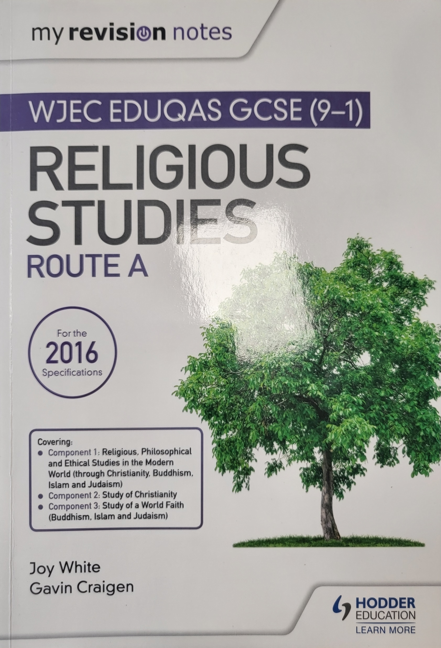
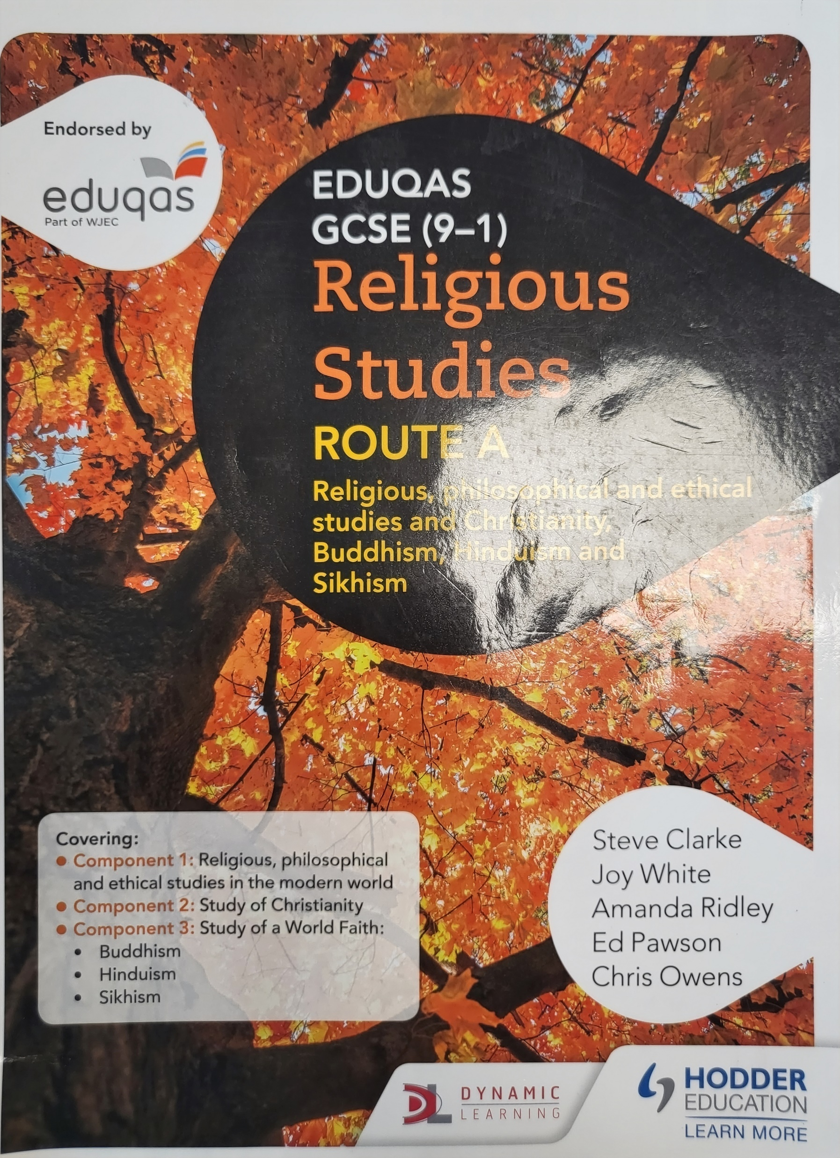
How do scholar best revise for RE?
Methods:
Mind maps
Flashcards
Revision clocks
Look cover write check using Cornell notes/keyword lists
Knowledge organisers in each of their booklets
Revision lists in their booklets
Revising sources of wisdom
Revising denominations for Christianity – have they got examples of specific beliefs relating to specific denominations/liberal or literal Christians?
Revise structure – practice timing themselves answering questions from the knowledge organiser
Revision guides/textbooks:

