Slide 1
The mathematics GCSE
Exam Board – AQA
3 exam papers each 1 hour 30 minutes, 80 marks
1 non-calculator paper, 2 papers with calculators
Each paper can have any content from across the whole specification. Questions get progressively harder.

Slide 2
Tiers of Entry
Foundation (grades 1-5)
Higher (grades 4-9)
Crossover content on both tiers includes quadratic equations, Pythagoras’ theorem and trigonometry.
Each exam paper is designed so it has accessible questions AND questions that stretch and challenge the most able.

Slide 3
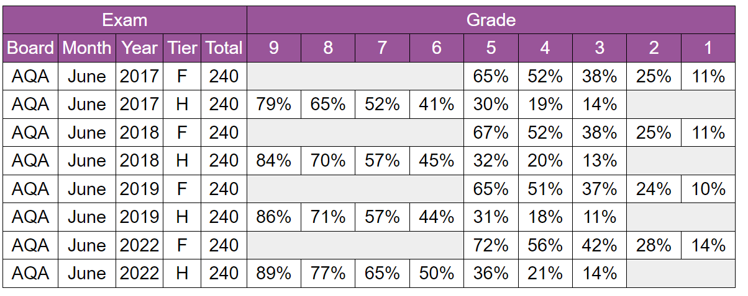

Slide 4
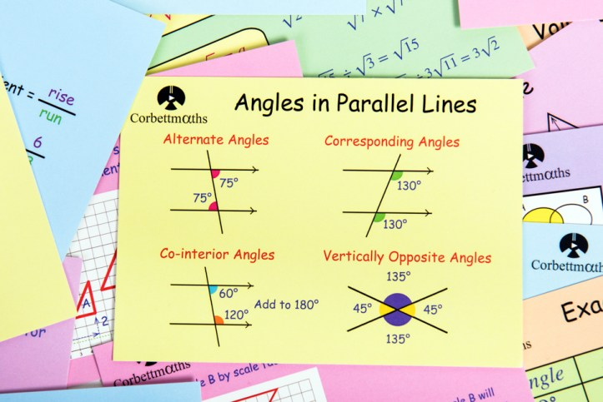
Flashcards – Formulae and Facts

Slide 5
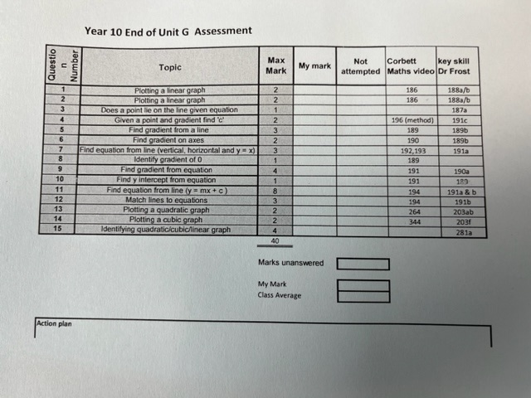
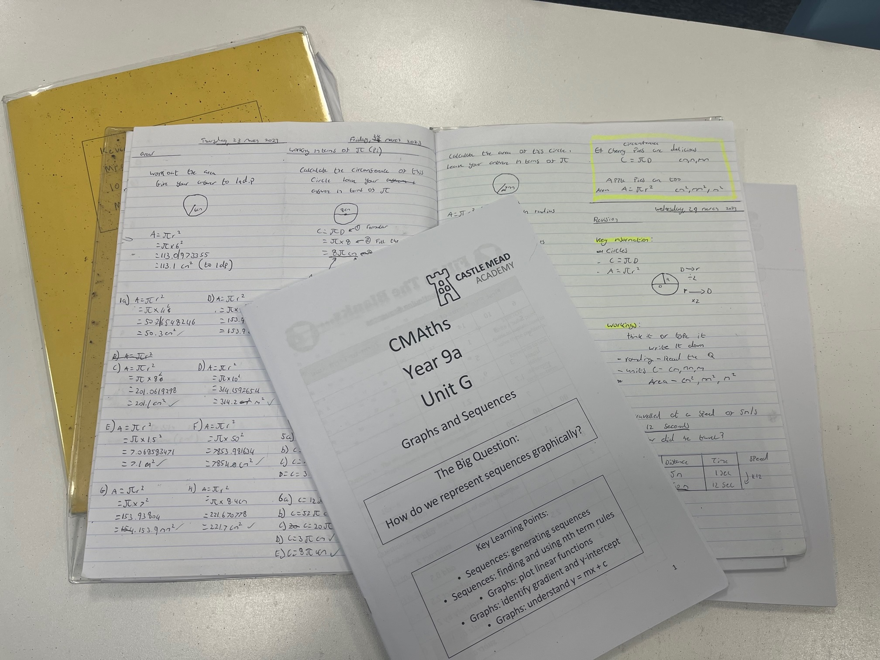
Exercise Books and Booklets
Assessment Feedback Sheet – indicates specific areas to work on

Slide 6
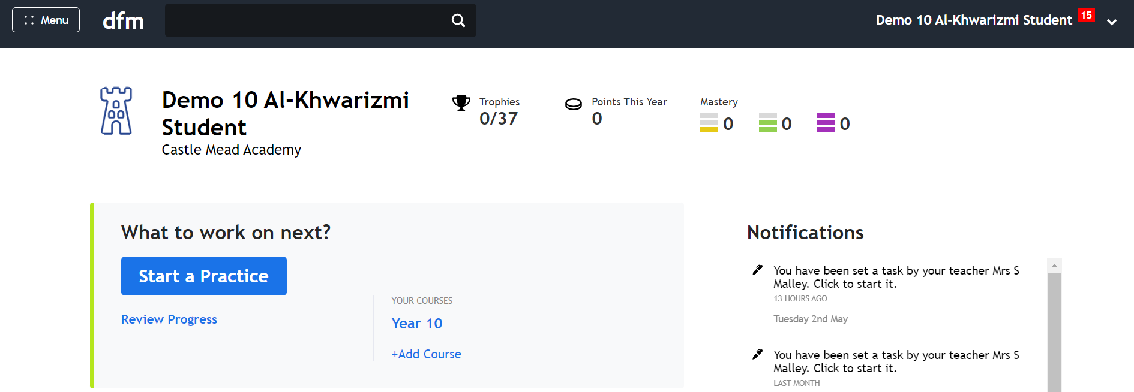
Dr Frost – click on your course
It will say your year group

Slide 7
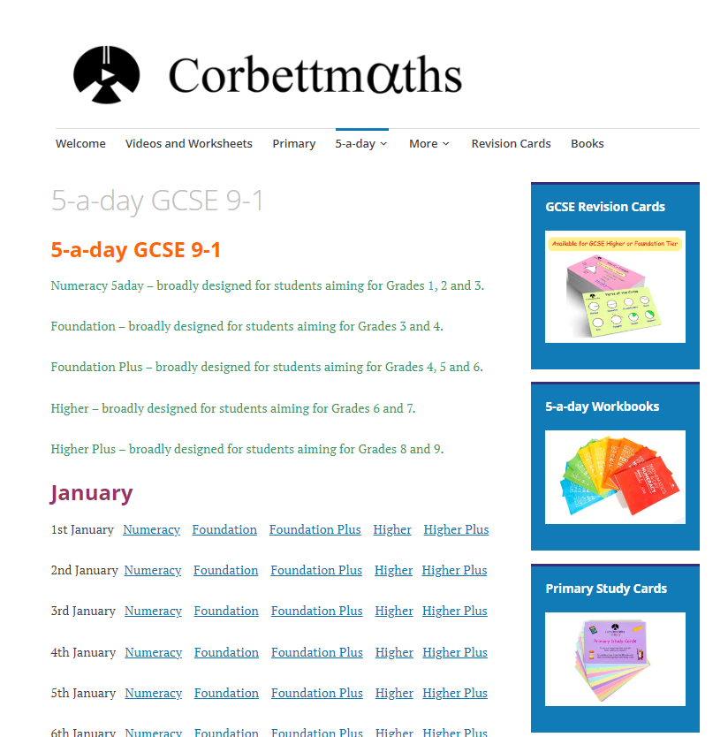
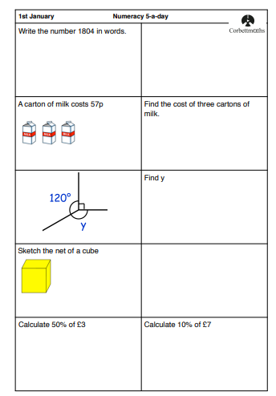
Corbett Maths - 5 a day

Slide 8
To do well in maths
Maximise your learning in lessons
Do your homework
Use Dr Frost
Learn facts and formulae
Summer Mock Exam is two papers and covers content up to summer half term.

