Slide 1


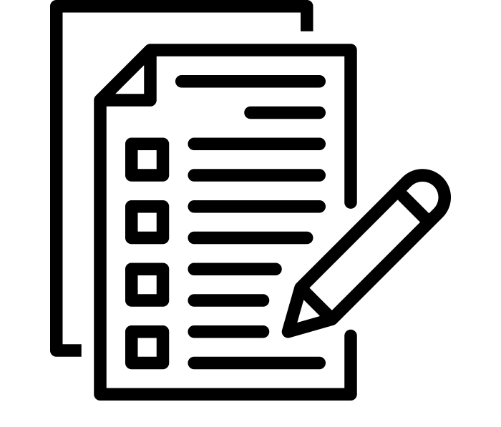

GCSE @ CMA
Qualification Details:
Qualification: GCSE
Exam board: Pearson Edexcel
Included in the English Baccalaureate award
How is the History GCSE Assessed?
Assessment Pathway:
3 GCSE exam papers at the end of Year 11
Paper 1: Thematic study and historic environment
Written examination: 1 hr and 15 mins
30% of the qualification
Paper 2: Period study and British depth study
Written examination: 1 hr and 45 mins
40% of the qualification
Paper 3: Modern depth study
Written examination: 1 hr and 20 mins
30% of the qualification
How can I support my child prepare for their History GCSE?
Notes:
Teacher Exposition:
There is NO coursework element within the assessment of GCSE History.
The four studies scholars complete over Year 10 and 11 are assessed across three papers.
The Papers are broken down as:
[Reveal]
Paper 1:
A Thematic Study and Historic Environment: (To be completed in Year 11)
Migrants in Britain, c800–present and Notting Hill, c1948–c1970.
[Reveal]
Paper 2:
Period study option:
Superpower relations and the Cold War, 1941–91
AND
British depth study option: (To be completed in Year 11)
The reigns of King Richard I and King John, 1189–1216
[Reveal]
Paper 3:
Modern depth study:
Mao’s China, 1945–76

Slide 2
GCSE @ CMA
End of Year Exam:
1.5 MOCK GCSE exam papers at the end of Year 10
Paper 1 – Monday 5th June (PM)
Paper 3: Modern depth study
Written examination: 1 hr and 20 mins
Covering content studied so far, including:
Chinese Civil War
The Hundred Flowers Campaign
The First Five-Year Plan
What will the Year 10 End of Year Exam Look Like?
Question Types assessed:
What I can infer from a source (4 marks)
Explaining why an event happened (12 marks)
Judging the utility (how useful) two sources are (8 marks)
Explain HOW and WHY interpretations differ (4+4 marks)
Explaining HOW FAR you agree with an interpretation (16 marks)
How can I support my child prepare for their History GCSE?
Notes:
Teacher Exposition:
As we are halfway through the course – you will sit half of the exams compared to the end of Yr11.
This is great practice! It will help you get a sense of what’s to come, build confidence and allow us to address mistake over the coming year.
[Reveal]
Paper 1 Details (Is based on a GCSE Paper 3)
[Reveal]
This is the content the EoY exam will cover (you will receive a full ‘revision list’)
[Reveal]
These are the question types. You are familiar with them all, apart from the 16 mark, which we shall practise in the final week of this half term.

Slide 3
GCSE @ CMA
End of Year Exam:
1.5 MOCK GCSE exam papers at the end of Year 10
Paper 2 – Friday 9th June (PM)
Paper 2: Period study
Written examination: 50 minutes
40% of the qualification
Covering content studied earlier this year:
The Wartime Conferences
The Berlin Crises and Formation of NATO
The Cuban Missile Crisis
The Collapse of the USSR
What will the Year 10 End of Year Exam Look Like?
Question Types assessed:
Explain two consequences (of an event) (8 marks)
Write a narrative account (tell the story of) of an event (8 marks)
Explain the importance of an event (8 marks)
How can I support my child prepare for their History GCSE?
Notes:
Teacher Exposition:
[Reveal]
Paper 2 Details
[Reveal]
This is the content the EoY exam will cover (you will receive a full ‘revision list’)
[Reveal]
These are the question types. You are familiar with them all, and have practised them in your homework booklets this term.

Slide 4
GCSE @ CMA
How to revise for GCSE History:
Know your Knowledge Organisers – create flashcards from them / quiz yourself / Look / Cover / Write / Check and create Revision Clocks.
Know the Stories in your booklets – cover over the text and re-tell the story using your dual-coded notes down the right hand side.
Know the causes / consequences and importance of the events we have studied.
Know the question types – BUG them and know what each one requires.
How best to revise for History
How can I support my child prepare for their History GCSE?
Notes:
Teacher Exposition:
You need to make sure you KNOW YOUR STUFF! There is no escaping this, use flashcards / your KOs and or a Revision Clock to secure it in your long term memory.
Know the question types you will face and what each one requires. We have practised these often. Consider how you would tackle them and what knowledge you would apply if a topic came up… you’ll need to EXPLAIN for the highest marks so ask yourself WHY, WHT, WHY – and be sure you could answer this.

