Slide 1
Welcome to Geography

Slide 2
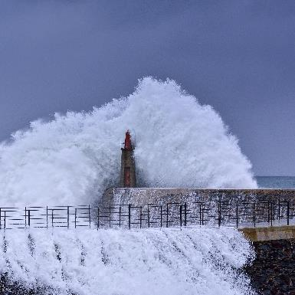
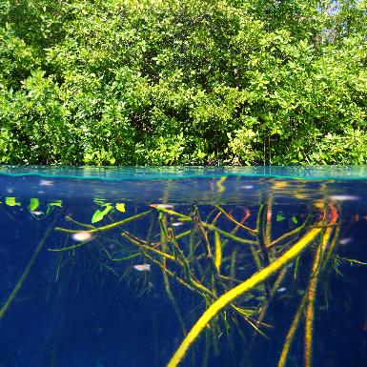
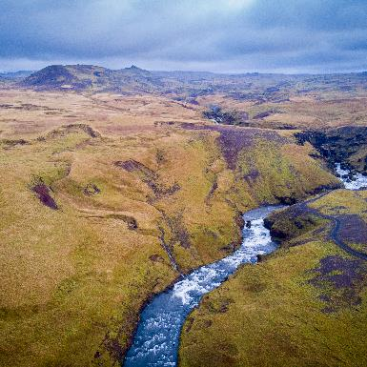
Paper 1: Physical Geography
Tectonic hazards
Weather hazards
Climate change
Ecosystems
Tropical rainforests
Hot deserts
Coastal landscapes in the UK
River landscapes in the UK
What if you lived in the path of a hurricane?
What if all the world’s rainforests were cut down?
What if all UK landscapes were made of the same rock?
Notes:
Our course is linear. All exams in Summer 2024. No coursework
35%, 35%, 30%. 90 minutes.
Scholars will be required to retrieve knowledge and also interpret a wide range of maps, graphs and figures.

Slide 3
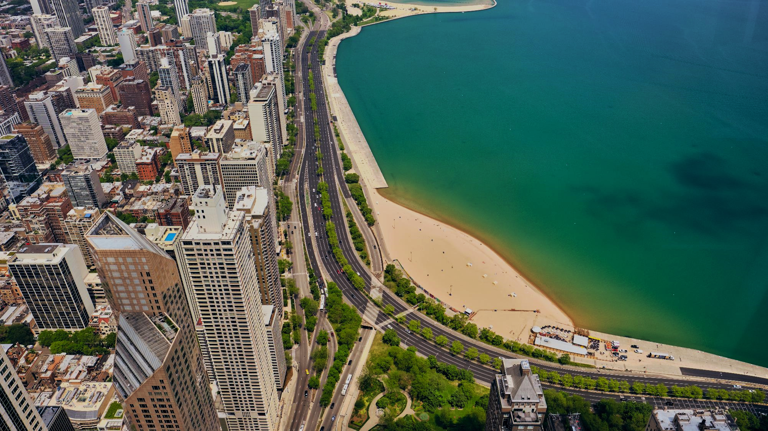
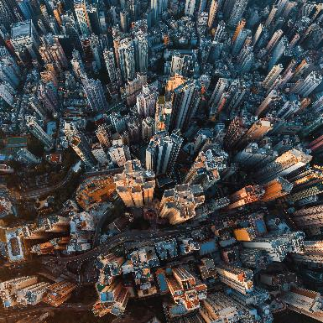
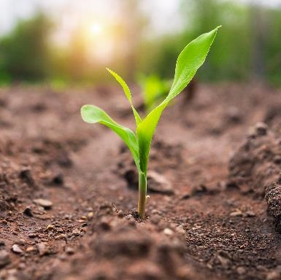
Paper 2: Human Geography
Global patterns of urban change
Urban growth in Rio de Janeiro, Brazil
Urban change in Leicester
Urban sustainability
The global development gap
Rapid economic development in Brazil
The changing UK economy
Management of natural resources including food, water, and energy
What if there was no countryside?
What if there was no international aid?
What if the only food we ate was genetically modified?

Slide 4
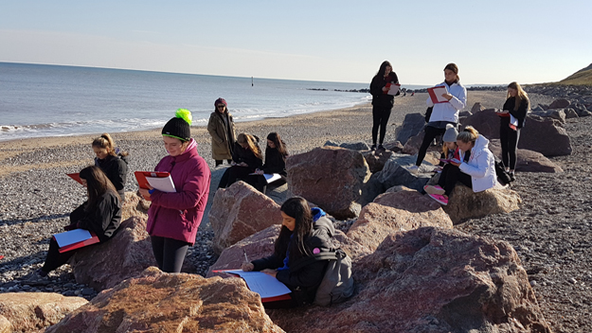
Paper 3: Geographical Skills
Pre Release Issue Evaluation
(this could be related to any part of our course!)
Unseen fieldwork questions
Questions on own fieldwork experience

Slide 5
Notes:
Scholars will be required to retrieve place specific knowledge, apply their knowledge and develop their points.

Slide 6
How should I revise for Geography?
Revision guides
Curriculum booklets
Revision clocks
Flash cards
Look / Cover / Check
Discuss topical issues!
Notes:
WARNING – case studies will be different – check stickers!
Families – take it as a learning opportunity.

