Slide 1
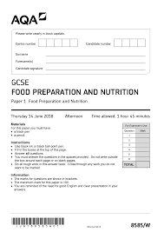
Welcome to Food Preparation and Nutrition
Written Exam-
50% of the final grade
20 marks multiple choice
80 marks extended answer

Slide 2
Top tips for success in the written exam
100% attendance.
Use of key terminology.
Revise using approved resources available from school.
Read the question twice
Answer all questions

Slide 3
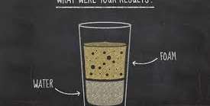
NEA- A total of 50 % of the grade.
NEA1 -15%
NEA1: Food science report
Example brief
What is the function of yeast in bread?

Slide 4
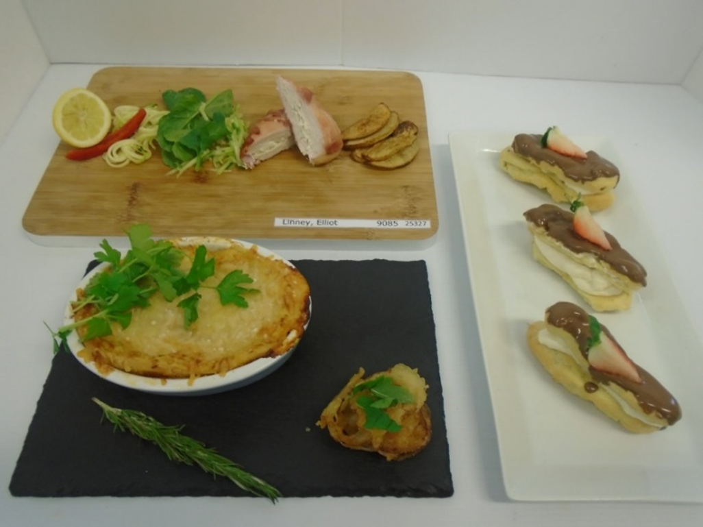
NEA- A total of 50 % of the grade.
NEA 2 -35%
NEA2: Food Preparation task
Example brief
Plan prepare and make a dish from an international cuisine

