Slide 1
Consider the below question and prompts; discuss with your child before we begin.
How can you support your child during summer mock exams and beyond?
What subject went well during report?
What subject do you need to work on?
What have you been doing to work on that?
How often have you been revising for your subjects so far?
Notes:
- Purpose of the evening is to work together to achieve the best for your child and see how best we can support them.
In this presentation, you are going to hear from
-curriculum leaders of the core subjects on what the GCSE exam will be, the course and the summer mock exam

Slide 2
Family Briefing: Exam Preparation
Part 1- Presentation in the theatre by:
1. Miss Thorley (Assistant Principal- Achievement)
2. Curriculum Leader of Core Subjects
3. Mrs Yazdani (Head of Scholar Wellbeing)
Part 2- Carousel of option subjects
Part 3- Return to the Dining Hall for summary and revision resources.

Slide 3
School
Success for our scholars
Scholars
Families
Notes:
In order to ensure the success for the scholars, it is important to see it as a triangulation of families, scholars and schools.
School:
Lessons/ homework/ enrichement opportunities (CCT etc)/ masterclasses
Scholars:
Working hard in lessons, completely homework on time, personal responsibility
Families:
- Sending scholars in, supporting from home, working with school, contacting teachers if need to

Slide 4
CMA Journey
Final Achievement Report
May to June 2024: GCSE Exams
YOUR NEXT STEP!!!
February: Year 11 Final Mocks
January: Year 11 final Parents’ Evening
Year 11 Achievement Report
Year 11 November mocks
Half Term 1: Year 11 Parents’ Evening
Post 16 Applications
Fresh Start: Year 11 begins
July: End of Year Trip
July: Final Year 10 Achievement Report
June: Year 10 Mock Exams
April: Work Experience Week
Three years of work at KS3 and Year 10 Term 1 and term 2
Notes:
Let’s consider our CMA journey. Firstly, it is important that we do not miss out including your three year of hard work in Year 7, 8 and 9 and also term 1 of year 10. But what does our remaining CMA journey look like?
This journey was shared with Year 10 in January as a reminder of how far they have come and the next steps on their CMA journey, highlighting ‘fresh starts’
We are all on this journey together, families, scholars teachers- we want your child to be successful in whatever they want to do next. GCSES are not the end goal but they are part of the journey.
All the knowledge they are learning helps them grow and well rounded scholars/ young adults.

Slide 5
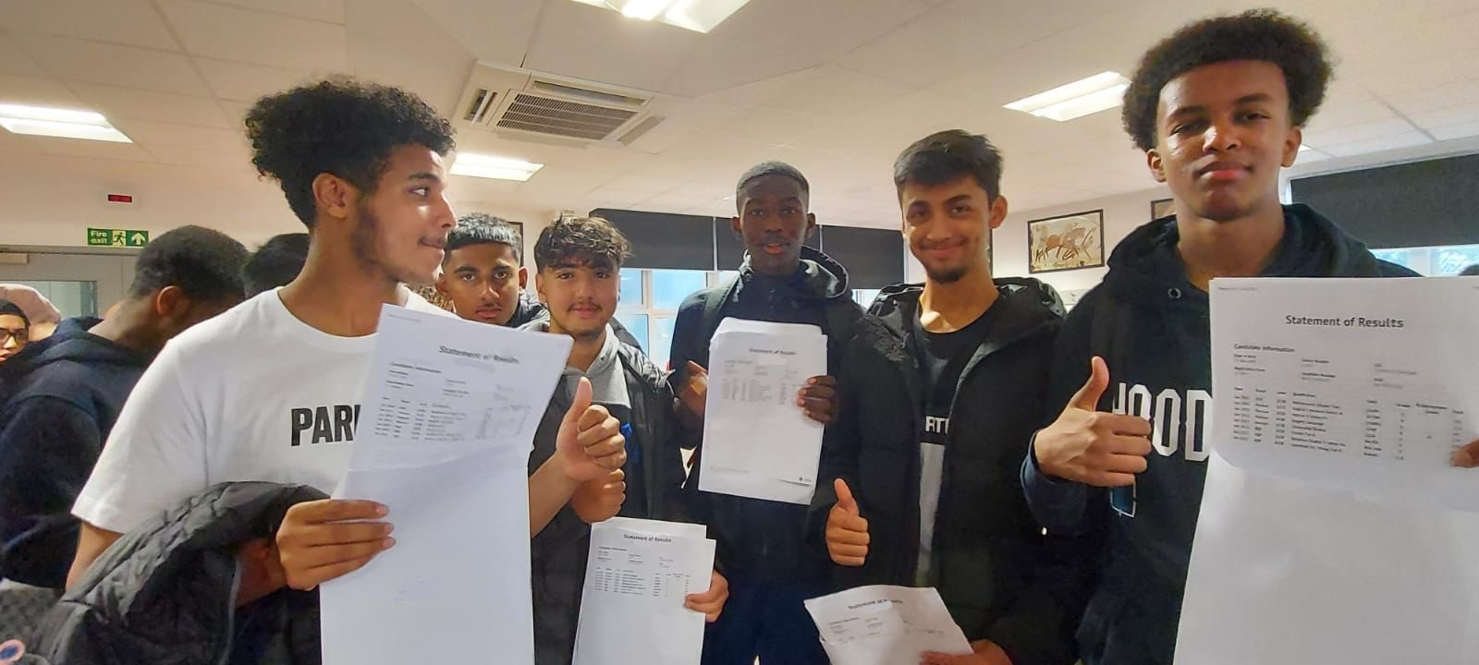
Notes:
Same goal- we want our scholars to be proud of their results ready for their next steps in life.

Slide 6
OLD GCSE GRADE | NEW GCSE GRADE
Top 20% of A/ A* will achieve a grade 9 | 9
A+/A* | 8
A | 7
B/B+ | 6
C+/B- | 5 = new strong pass
C | 4= new standard pass
E+/D | 3
F/E | 2
G/F- | 1
Notes:
A* has been split into two grades (around 5% of the country will achieve a grade 9 determined after whole cohort has sat the exams)
Both 4 and 5 are seen as a ‘pass’ with 5 being a strong pass. However, this depends on next steps which I will discuss more later.

Slide 7
GCSE Facts
Scholars will share their GCSE results for the rest of their life; when they apply to colleges, university, and any job!
You need a minimum of grade 4 in Maths and English for most college courses, A Levels, apprenticeships, jobs and university degrees.
For some A Levels you need a minimum of a grade 5 in Maths and English

Slide 8
Post 16- Next Steps
Level 3 Vocational Course in Business: Minimum of 5 GCSES of grade 4-9, with a minimum of grade 4 in English and Maths
Intermediate Apprenticeships (for example; hair and beauty, construction, business, accountancy): Minimum grade 4 in English and Maths
Beauchamp City Sixth Form (A Levels)- 6 grade 5’s, including at least a grade 5 in English Literature or Language, and a grade 5 in Maths.
Notes:
Apprenticeship is paid work alongside college work.

Slide 9
Importance of Grade 4
Scholars will have to resit their English and Maths if they do not get the minimum grade.
Currently at CMA: 5 x Maths Lessons a week and 7 x English Lessons a week (English Literature and Language)
If scholars have to resit, they will study this alongside their course.
How can you help? Discuss with your child their current predicted grade for Maths and English. Speak to your child about the next steps/ any worries they have.
Notes:
English two subjects

Slide 10
GCSE Facts
Scholars who read books more than once a week gain higher results in all GCSE’s compared to those who read less regularly.
How can you help? Encourage your child to read in the evening and check they have a reading book.
Notes:
Reading opinion things- guardian/ bbc

Slide 11
Opportunities in school
After school tutoring
Masterclasses during Prep
Academic Mentor Support
Subject Drop In/ After school Sessions
Staff Support
Notes:
More letters have gone out
Masterclasses in English/ maths/ now science
English and maths academic mentor support

Slide 12
Summer Mock Exams
Week commencing 5th June for a week in the sports hall.
Access arrangements will be in place. Mrs Turner (SENDCO) will be available during the carousel in the dining hall if you have any questions.
Why?
Helps scholars to familiarise and understand the process for year 11
To help both the scholars and the teachers identify strengths and success and understand any gaps in knowledge.
Notes:
First insight into the exam timetable.

Slide 13
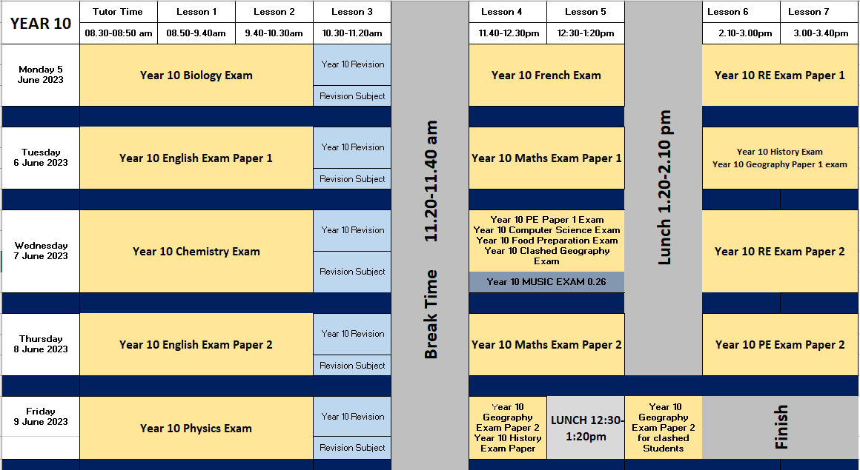
Notes:
First insight into the exam timetable.
Scholars will be receiving an exam timetable and one will be sent home to you as well.

Slide 14
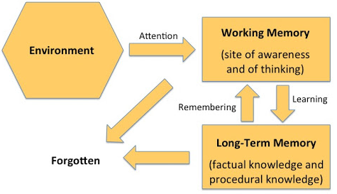
Memory
We take in information from all around us in a variety of ways.
We see, hear, taste, smell and feel things that we are aware of and our brain notices.
Notes:
Let’s start by looking at how memory works.
We take information in from all around us in the environment….

Slide 15
Memory
Once we’ve noticed and used it we either forget the information or we learn it.
If it has been learnt it is then stored in the long term memory.

Slide 16
Memory
Over time we can remember information, bringing it back from long term memory to the working memory.
If we don’t re-use the information in a long time our brain’s think we don’t need it anymore and we will forget it.

Slide 17
What does it mean to learn?
Learning is what happens when information is transferred into our long term memory.
Information is processed and used in the working memory first but if we use it regularly enough the information passes to the long term memory.
We want our knowledge to be in the long-term memory and the solution is retrieval and revision!
Notes:
We practice retrieval every lesson in each subject. Revision shouldn’t be feared because we are constantly retrieving our knowledge in lessons to help move it to our long term memory. Revision is an additional step.

Slide 18
Practice make perfect?
Daniel Willingham:
The unexpected finding from cognitive science is that practice does not make perfect.
Practice until you are perfect and you will be perfect only briefly.
What's necessary is sustained practice.
Sustained practice: regular, ongoing review of the 'target material'. This kind of practice past the point of mastery is necessary to meet any of these three important goals of instruction: acquiring facts and knowledge, learning skills, or becoming an expert.
Notes:
Lined paper needed

Slide 19
How can you support your child?
1. Revision: little and often
Flashcards on the fridge
Test them/ get younger siblings to test them
Put their exam timetable up
Remove their technology when completing work/homework and give them a timer instead.
2. Organisation
Ensure they have all their year 10 books and resources
Make sure they are bringing equipment each day
Fill out the forms link if you need any equipment
3. Revision and Exam Prep Checklist
Collect a checklist on your way out and go through this with your child

Slide 20
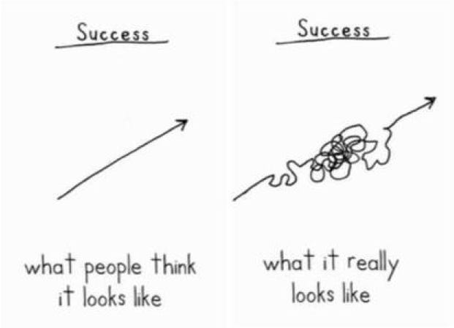
Notes:
- Some don’t need a fresh start- keep going, keep working hard.

Slide 21
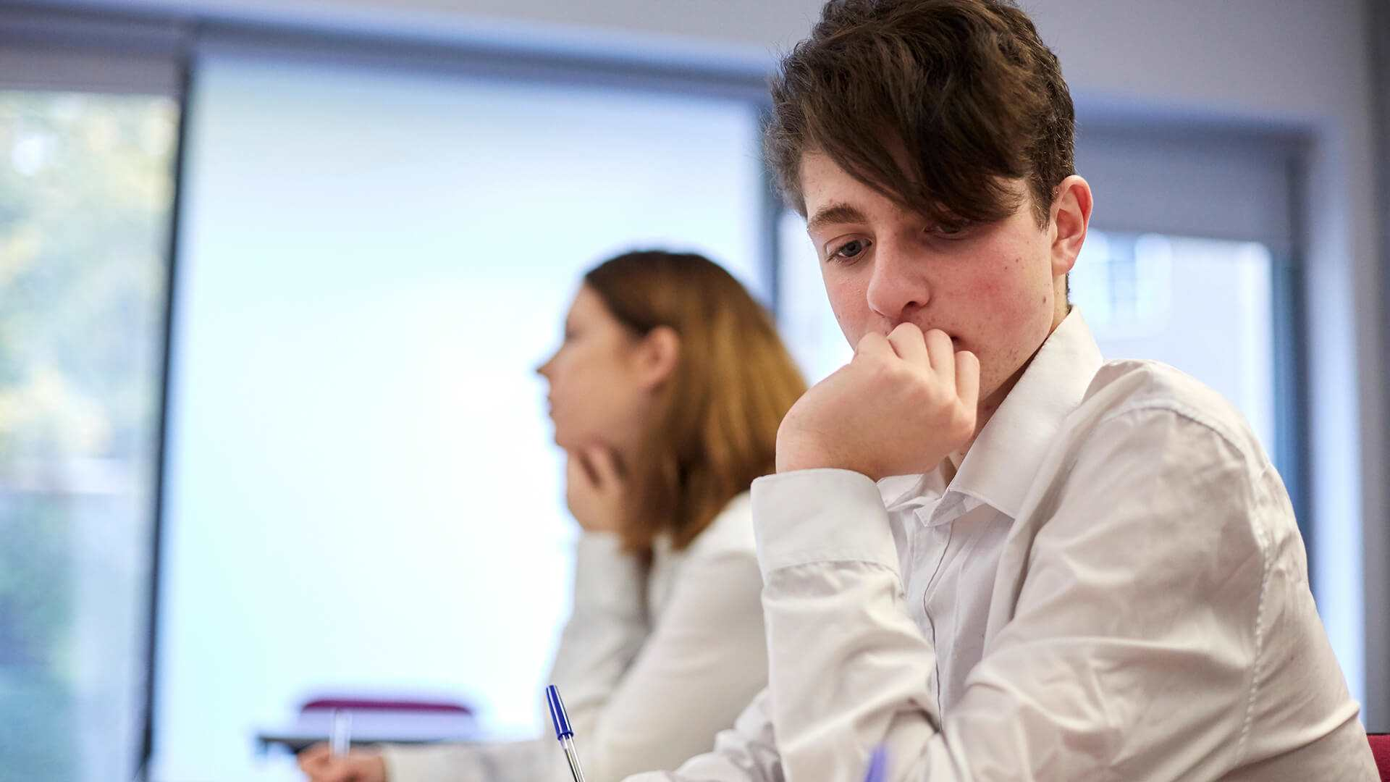
Supporting your child during exam season

Slide 22
Exams are a stressful time for any young person
Some common things you may notice as signs of struggling
Angry or emotional outbursts
Feeling more tired than usual
Difficulty sleeping
Changes in eating habits
Not wanting to talk about things or becoming more closed off than usual

Slide 23
What can you do to help your child?
Perspective
Positive
Praise

Slide 24
We believe that respect is mutual
Scaling 1 – 10
10 being the best OR most
School?
Mood?
Stress?
Exams?
Worries?
Sleep?
Happiness ?

Slide 25
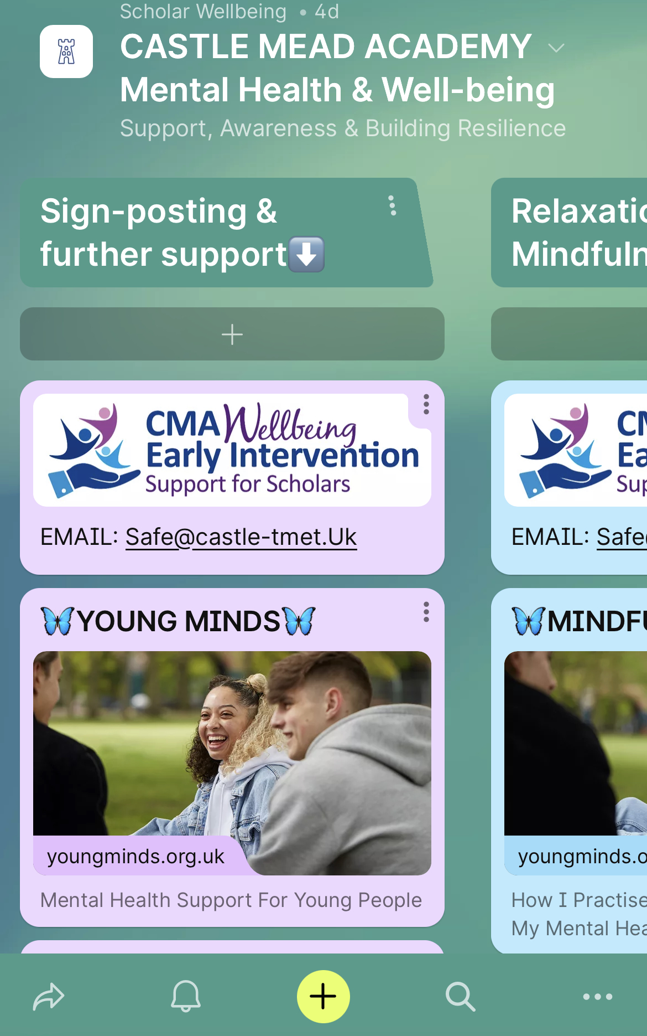
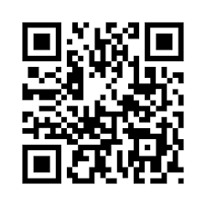
2 of my favorite go to apps for young people

Slide 26
Carousel for Option Subjects (6.10-6.40pm)
History (0.16)
Geography (0.17)
Computer Science (0.18)
Textiles (0.28)
Food Preparation and Nutrition (0.33)
Art (0.32)
Inclusion Support (Dining Hall)
Meet back in the dining hall for summary and revision resources!
Notes:
Music and PE unavailable

