Slide 1
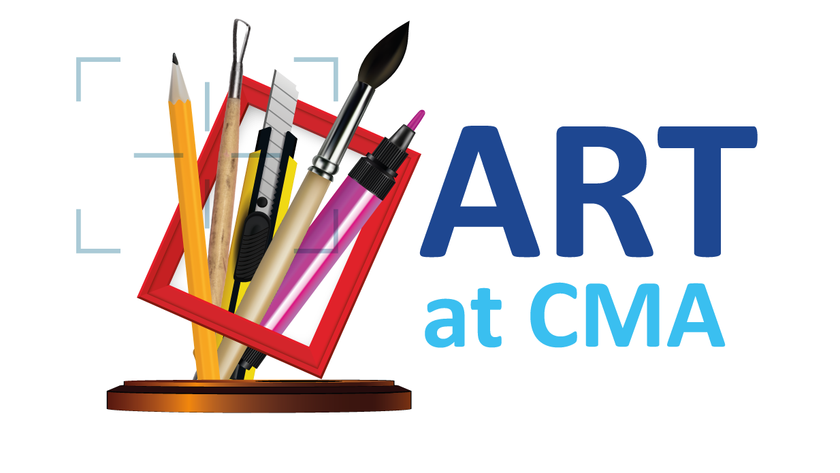
What will the GCSE exam look like in Year 11?
The GCSE course is split into two sections across the two years
60% Portfolio project
40% Exam Portfolio project
Over the two year course, scholars will create these two projects.
As it is a coursework based subject, it is essential scholars meet homework and classwork deadlines as an absolute bare minimum.

Slide 2
What will the summer mock exam will look like?
End of year 10 Mock:
A five hour exam in the Art Studio held at the end of June 2023
They will work independently for one day, with technical support from invigilators and technicians if needed.
They will create an ‘outcome’ from their portfolio project this year.
They are ‘off-timetable’ and do not go to any other lessons this day.
They will have break and lunch and finish school at the normal time of 3:40pm
This will help prepare them for the real 10 hour exam at the end of year 11.
They will spot areas that they need to improve and weaknesses in their project, well in advance of the main deadlines so that they can work and improve their portfolios.
They will also have a confidence boost that will encourage them and make them realise that they can work like artists for extended amounts of time.

Slide 3
How do scholars best revise for their Art exams?
It is a coursework based subject, it is essential scholars meet homework and classwork deadlines as an absolute bare minimum….
….This is their revision!
They are able to take their portfolio sketchbook, all their preliminary sketches and photographs and anything else they need,into the exam. The more prepared they are the better they will do in their exams.
Practise, practise, practise – drawing skills, taking photographs, painting, using mixed media – whatever it is they are planning for their exam, they need to practise it and put the evidence in their sketchbook.
Make sure for the exam, your scholars have a water bottle and plenty of rest the night before, doing an art exam is both mentally and physically demanding.

